Slide 1
Cryoprinting Hydrogels
Nivi Chandra Bose

Slide 2
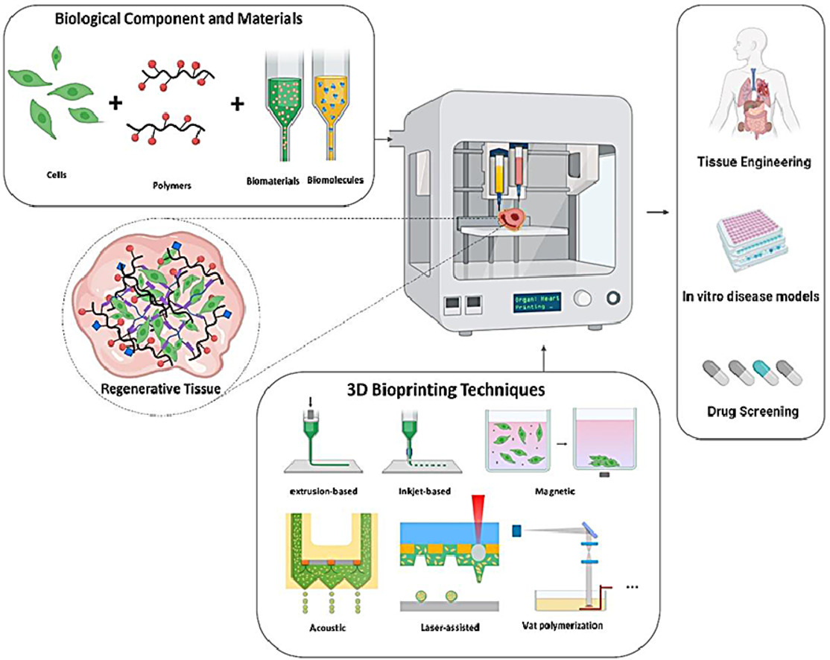
3D Bioprinting
[1]

Slide 3
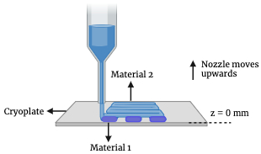
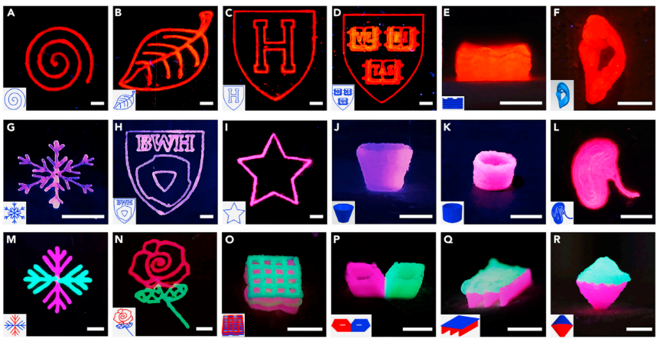
Cryoprinting
Schematic of multi-material 3D cryoprinting
Cryoprinted structures [2]

Slide 4
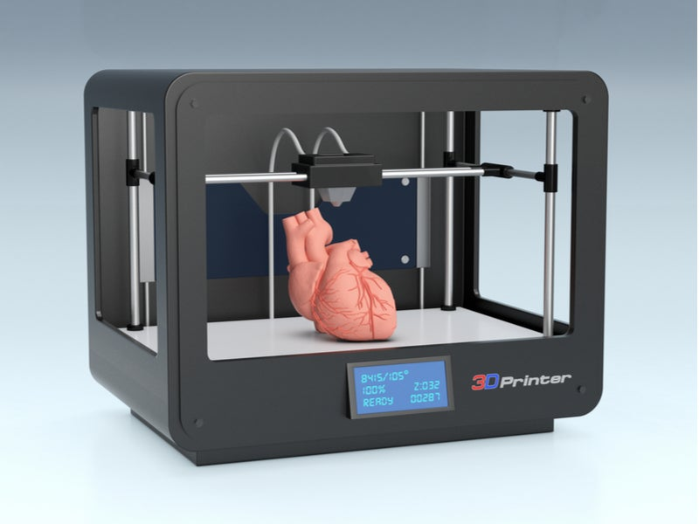
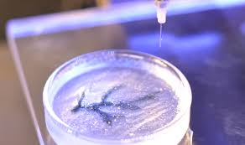
Applications
3D tissue constructs [7]
3D-organ printing [6]

Slide 5
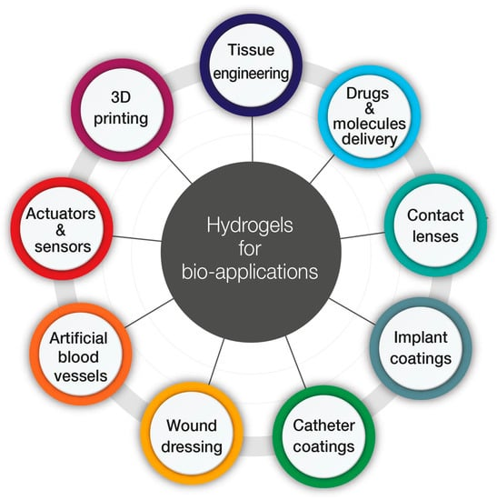
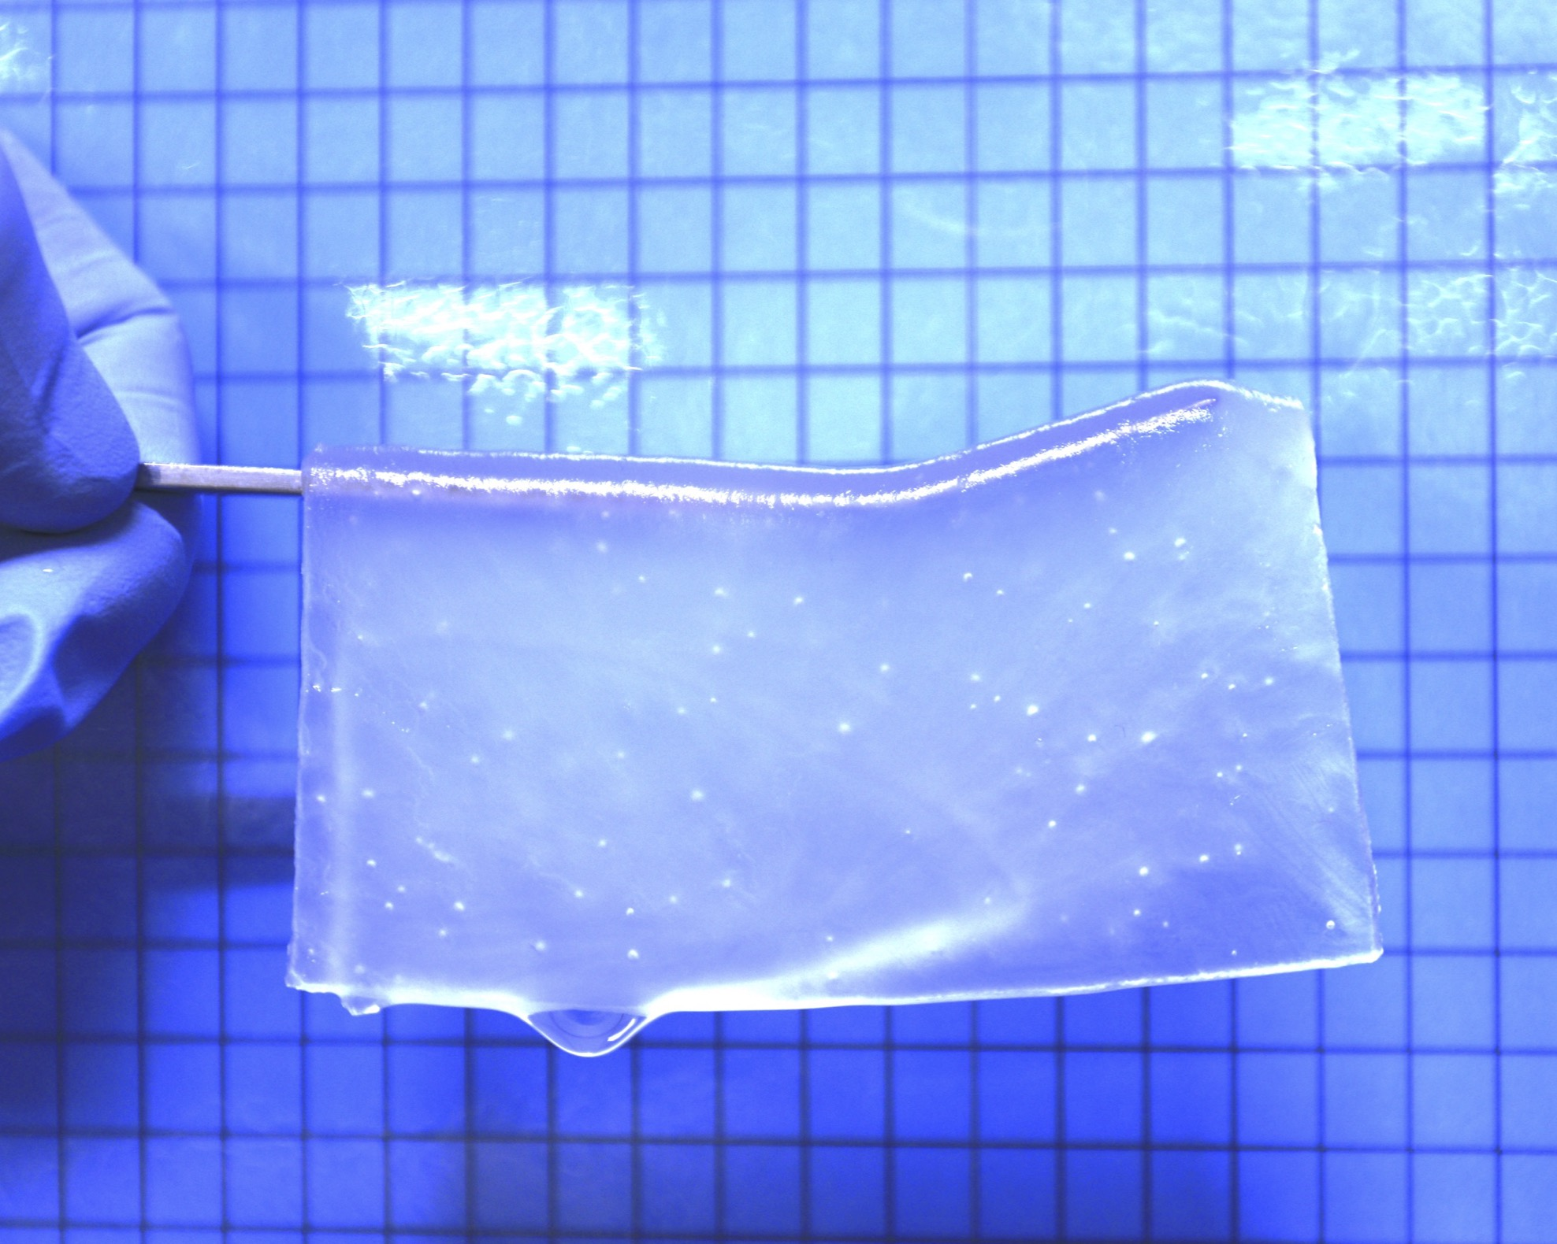
Hydrogels
A semi-transparent hydrogel [3]
Applications of hydrogels in biomedicine [4]

Slide 6
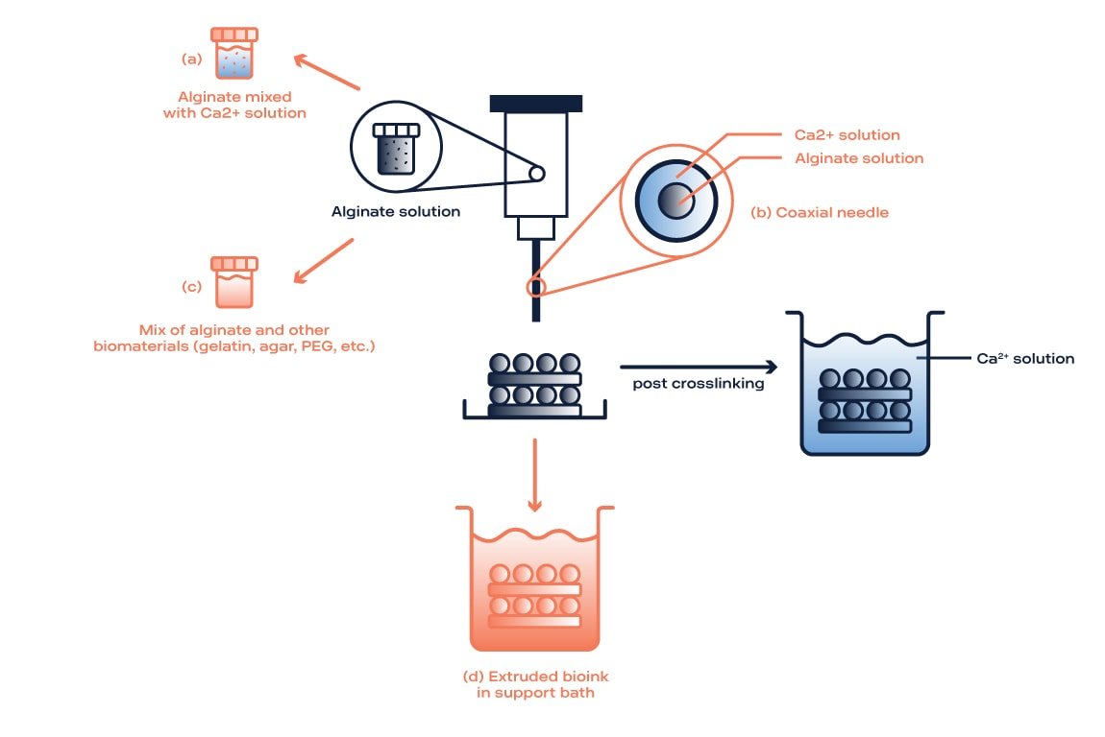
Alginate Hydrogel
Attempts at 3D extrusion printing of alginate
Methods of 3D printing pure alginate [5]

Slide 7
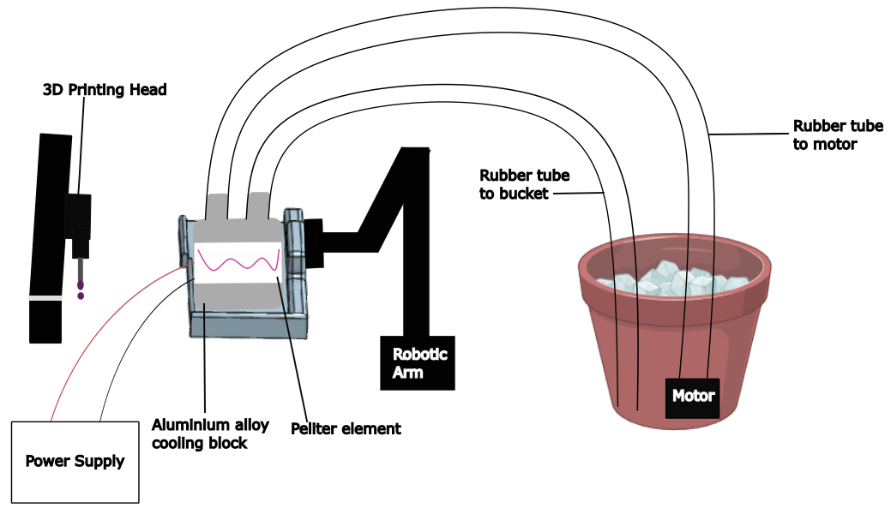
Cryoprinting Platform

Slide 8
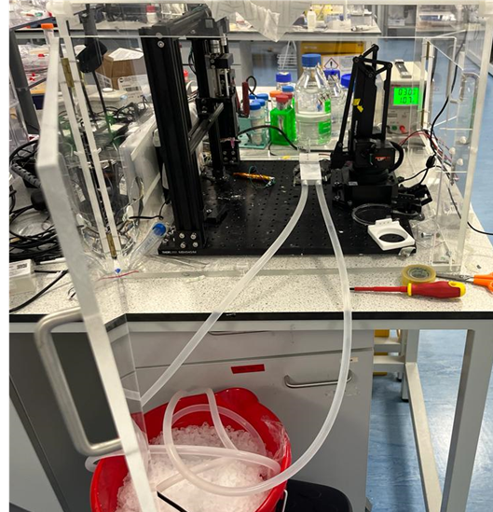
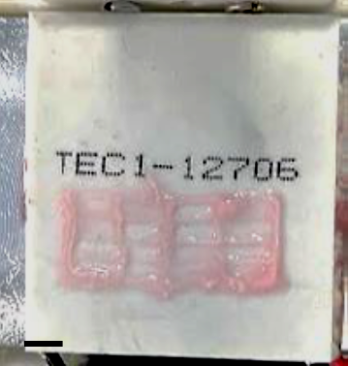
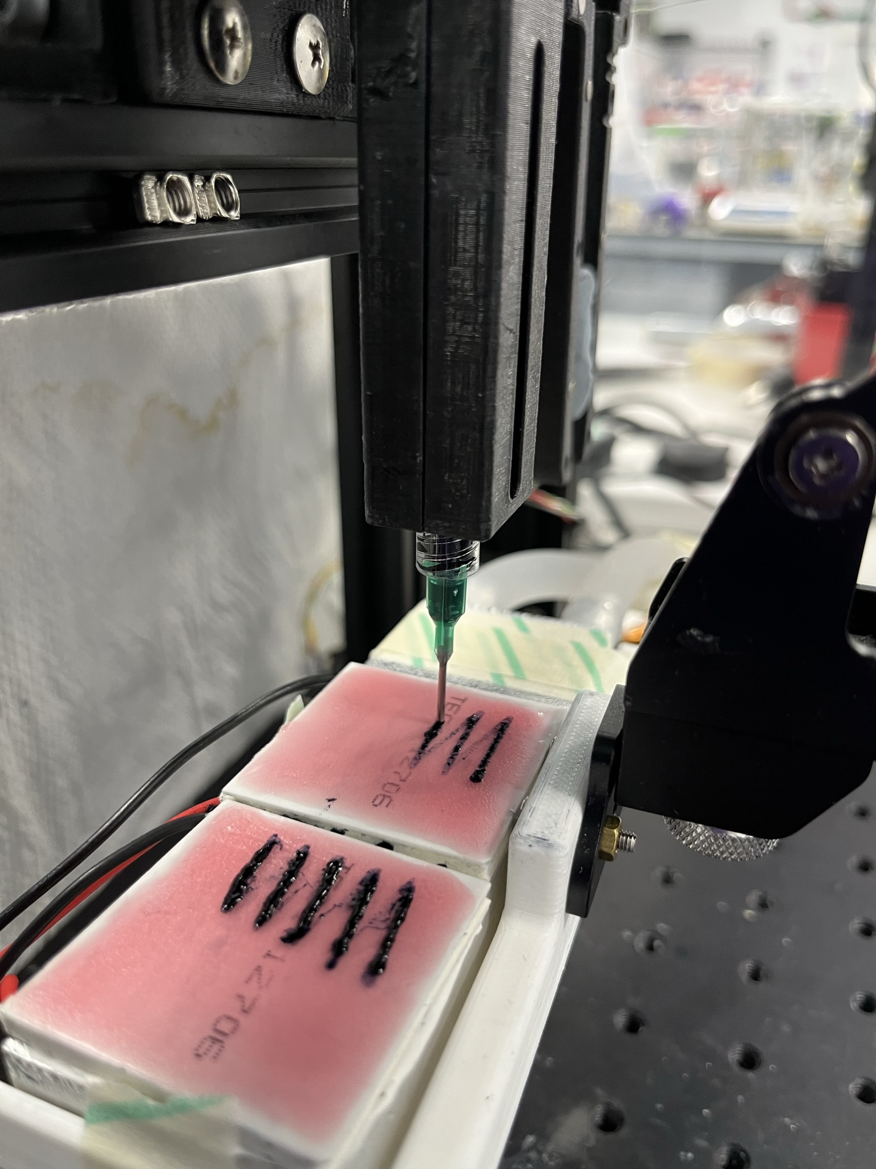
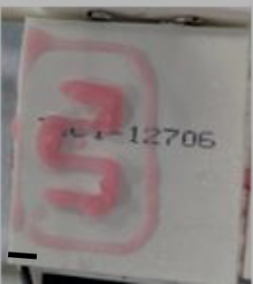
Cryoprinting Platform

Slide 9
References
[1] Vanaei, S., et al. (2021) 'An overview on materials and techniques in 3D bioprinting toward biomedical application', Engineered Regeneration, 2, pp. 1-18.
[2] Ravanbakhsh, H., Luo, Z., Zhang, X., Maharjan, S., Mirkarimi, H.S., Tang, G., Chávez-Madero, C., Mongeau, L. and Zhang, Y.S., 2022. Freeform cell-laden cryobioprinting for shelf-ready tissue fabrication and storage. Matter, 5(2), pp.573-593.
[3] Tanikawa, S., et al. (2023) 'Engineering of an electrically charged hydrogel implanted into a traumatic brain injury model for stepwise neuronal tissue reconstruction', Scientific Reports, 13(1), p.2233.
[4] Kapusta, O., et al. (2023) 'Antimicrobial Natural Hydrogels in Biomedicine: Properties, Applications, and Challenges—A Concise Review', International Journal of Molecular Sciences, 24(3), p.2191.
[5] Bonizol Camasao, D. (2021) 'Methods to 3D print alginate-based scaffolds', Rheolution Article, January. Available at: https://rheolution.com/rheolution-articles/methods-to-3d-print-alginate-based-scaffolds/#:~:text=Some%20reported%20methods%20include%20(Section,and%20core%2C%20respectively%2C%20for%20rapid (Accessed: 1 June 2024).[6] Sanchez-Sanchez, A., del Agua, I., Malliaras, G.G. and Mecerreyes, D., 2019. Conductive poly (3, 4-ethylenedioxythiophene)(PEDOT)-based polymers and their applications in bioelectronics. In Smart Polymers and Their Applications (pp. 191-218). Woodhead Publishing.
[6] Kent, C. (2019, June 10). The future of bioprinting: A new frontier in regenerative healthcare. Medical Device Network. Retrieved June 14, 2024, from https://www.medicaldevice-network.com/features/future-of-3d-bioprinting/
[7] Carnegie Mellon University. (n.d.). Three-dimensional tissue constructs. Retrieved June 14, 2024, from https://engineering.cmu.edu/organs/research/3d-tissues.html

