Slide 1
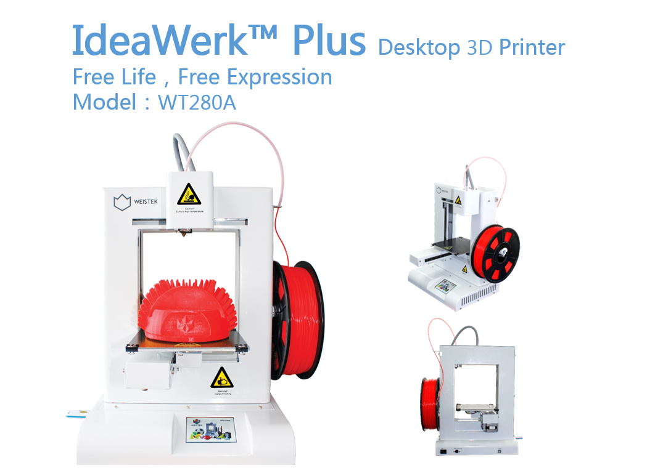
How to 3D Print in the Dyson Centre
Some images taken from http://ideawerk3dprinter.com
Updated versions will be available from:
www.dysoncentre.eng.cam.ac.uk/howto3dprint
Dyson Centre
For Engineering Design
This document is provided for users of the Dyson Centre only – no responsibility can be accepted for those outside of Cambridge’s Dyson Centre using it.
26 January 2016
Dr Richard Roebuck
Dyson Centre Manager
Comments and feedback would be welcome to: dyson-manager@eng.cam.ac.uk

Slide 2
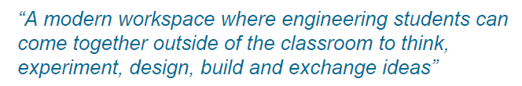
Overview of These Notes
Dyson Centre
For Engineering Design
Machines and Familiarisation
Materials (can skip want standard material offered)
Obtaining Things (STL Files) to Print Online (Thingiverse)
…Or Getting an STL File from Your CAD Package
Checking for Error Free STL File (viewstl.com)
Processing Your STL File For the 3D Printer (gives WTK File)
Printing you WTK on the 3D Printer
Charging for Materials Used
Health and Safety (Burns, Entrapment, Gassing and Fires!)

Slide 3
Machines and Familiarisation
Dyson Centre
For Engineering Design

Slide 4
Machines Available
Dyson Centre
For Engineering Design
Dyson Centre currently has 5 of the following IdeaWerk / RS machines:
  A Weistek WT280A (also know as an RS IdeaWerk Pro and IdeaWerk Plus)
Maximum component size:
150mm x 150mm x
140mm high.
Planning 5 more machines (type unknown), likely during Lent term.
If you’ve a particular machine suggestion or requirements, do say.

Slide 5
Machine Familiarisation
Dyson Centre
For Engineering Design
The extruder is a head which can move side-to-side.
Filament is drawn through low friction tube
It has a mechanism to draw the filament in at the top.
In the middle it heats the filament to above its melting point.
Reel of 1.75mm diam. filament (different colours/types available)
At the bottom it has a small nozzle out of which molten plastic is forced.
The platform can move front-and-back and up-and-down.
Hole for USB stick for transferring files to printer
It can be heated (which is necessary for some print jobs).
A thin removable sheet (a bed) is clipped to the platform – this is what is printed into.
Touch screen for operating printer
On-off switch on rear

Slide 6
Machine Familiarisation
Dyson Centre
For Engineering Design
Extruder can have
temperature set to anywhere between 190 and 280 degC
Platform can have temperature set to anywhere between room temperature and 100 deg C
The ability to set these two temperatures (above) is what governs the machine’s ability to print different materials.
The extruder must be able to melt the material to be printed.
The bed heating is to prevent items shrinking on cooling and warping away from the bed, which will spoil the object and force the print to be abandoned.
Caution also has to be given to any dangerous gases which might be given off on heating a material – don’t assume it is safe!!!

Slide 7
Materials Available
(Can Skip if Want Standard Material Offered – Known as PLA)
Dyson Centre
For Engineering Design

Slide 8

Materials Available: PLA
Dyson Centre
For Engineering Design
Noting previous slide (about machine capabilities)
We have available:
  PLA (polyester called polylactic acid or polylactide)
    It is derived from renewable sources such as corn starch.
    It is biodegradable and recyclable
    Extruder temperature 220 deg C
    Bed temperature 70 deg C for anything of significant size
    Currently stocking colours natural (off white) and red
    We could order-in black, white, blue, clear, yellow, grey, green, purple for around £25 per kg (for reasonable quality filament).
    Also (for up to twice the cost) fluorescent colours, gold colour, translucent filament, thermochromatic and photochromatic colours wood colours, filaments with sparkly inclusions.
    “PLA is an organic material, often made from corn starch or sugar cane, making it quite safe to use as far as fumes are concerned. Currently there is very limited official information available about the effects of PLA on our health.”
    Taken from http://3dprinthq.com/desktop-3d-printer-safety/

Slide 9

Materials Available: ABS
Dyson Centre
For Engineering Design
We also have available:
  ABS (acrylonitrile butadiene styrene)
    It is made from fossil fuels!
    “A few studies have shown ABS fumes to be toxic to rats and mice and there is a fair chance that ABS fumes are more harmful than PLA fumes, mostly due to higher levels of emissions and higher toxicity.” “Recent studies have shown that ABS emits around 10 times as many UFPs (Ultra Fine Particles) as PLA when heated, again making ABS more likely to affect our health than PLA.”
    Taken from http://3dprinthq.com/desktop-3d-printer-safety/
    It is recyclable
    Some biodegradable versions now coming on market, but not normally!
    Extruder temperature 240 deg C
    Bed temperature 100 deg C (or higher if possible) always!
    Currently stocking gold only.
    A range of colours are available.
    Technically stronger than PLA, however doesn’t bond to itself as well: resulting 3D printed parts are about same strength as PLA.
    A little bit more temperature resistance than PLA.

Slide 10
Materials Available: Others
Dyson Centre
For Engineering Design
Many other options available:
  Metal laden filaments
  Wood laden filament (sometimes referred to as wood)
  Flexible filaments
  HIPS (High Impact Polystyrene) which is dissolvable…might be useful for making a mould which can later be dissolved away.
  PC (polycarbonate)
  PA (polyamide)
  PVA (poly vinyl alcohol) which is water soluble…useful for moulds?
  Nylon
Note that we have yet to investigate any of the above, in terms of
  Availability (in 1.75mm diameter filament) / cost
  Safety of fumes
  How well our printers work with them
  If the printer may be harmed by using them (e.g. acidic compounds given off on heating).

Slide 11
Obtaining Things (STL Files) to Print Online
…Or Obtaining STL Files from CAD Packages
Dyson Centre
For Engineering Design

Slide 12
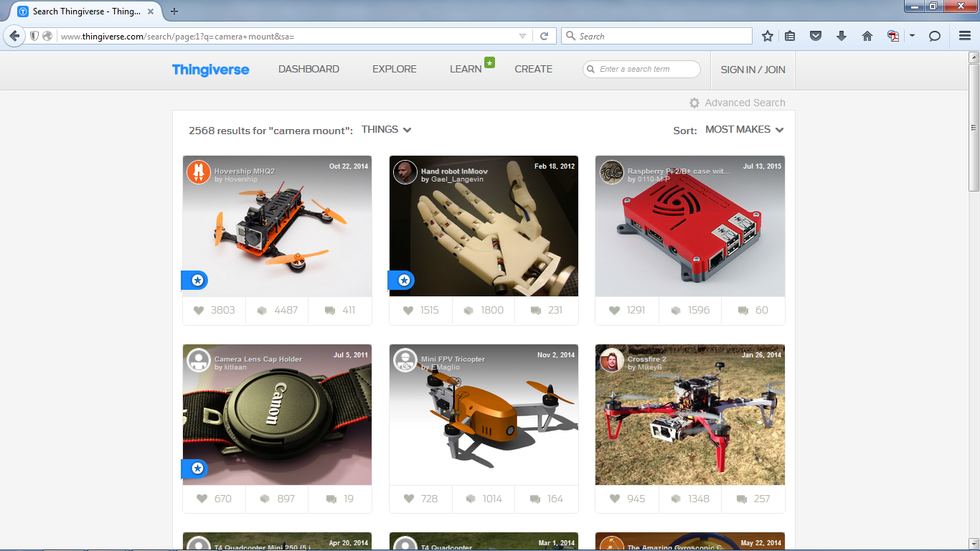
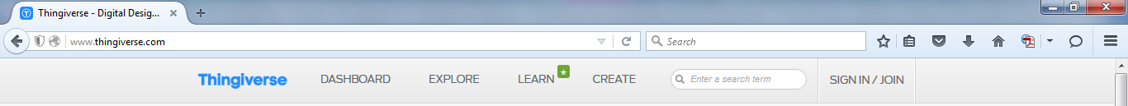
Obtaining Things (STL Files) to Print
Dyson Centre
For Engineering Design
Either create something to print in your favourite 3D drawing package
Or find something online you’d like to print and download its STL file:
  Sites such as thingiverse (a universe of thingys!) makes this very quick/easy:
Planning 5 more machines (type unknown), likely during Lent term.
If you’ve a particular machine suggestion or requirements, do say.

Slide 13
STL Files: Issues and From CAD
Dyson Centre
For Engineering Design
If using Thingiverse or similar, the file type for download is an STL file.
  STL: Standard Triangle/Tessellation Language – representations of the surfaces of your object as series of triangles in three dimensional space.
If drawing in your favourite 3D drawing package, such as:
  [formerly Google’s] Sketchup
  Creo (Pro-Engineer)
  Solidworks
  AutoDesk Inventor
  Catia
  …see www.dysoncentre.eng.cam.ac.uk/stl if you need help outputting STL files.
  Note that molten plastic has to be supported, so consider adding supports in your model – we’ll return to this later on!
Important: STL file generation very sensitive to settings
  Need to check the STL file provides closed (watertight) surfaces.
  Still the case with Thingiverse STL files, or if file has been 3D printed before.
  (Because different printer software processes STL files in differently)
  IronCAD
  McNeel Rhino
  Solid Edge
  UGS NX

Slide 14
Checking Your STL File For Errors
Dyson Centre
For Engineering Design
Online part source, such as Thingiverse
CAD Package
STL File Checker
Checked
STL File
Unchecked STL File

Slide 15
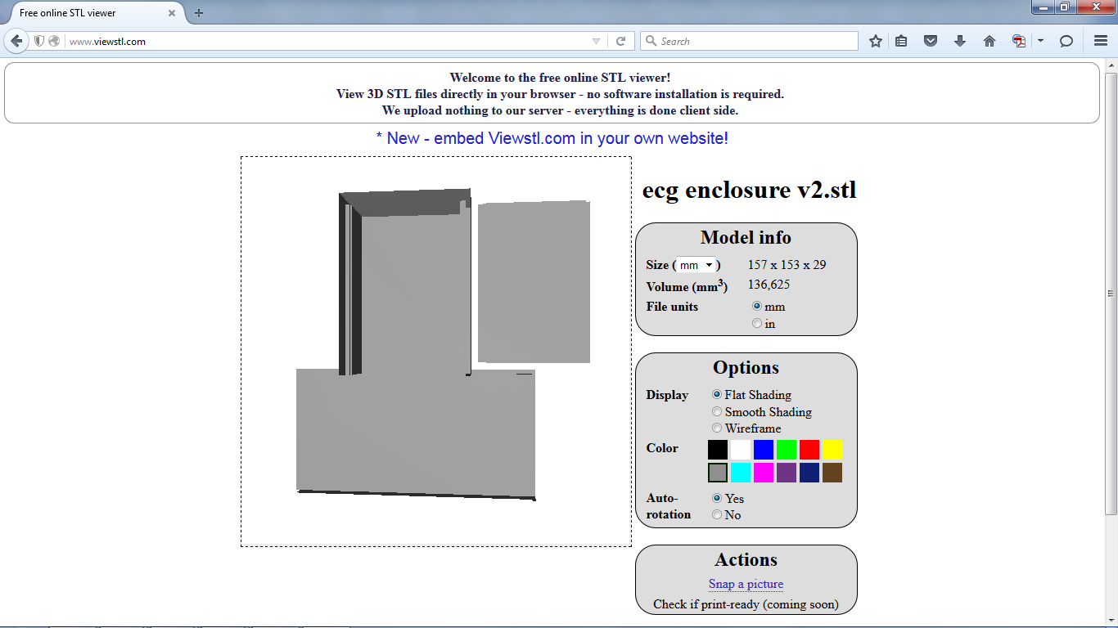
Checking Your STL File For Errors
Dyson Centre
For Engineering Design
A quick check of STL files can be done with a viewer
  E.g. go to www.viewstl.com and drag/drop (or upload) your (<35MB) STL file.
Online site spins object for you…
currently looks okay…
Version 2 of file!

Slide 16
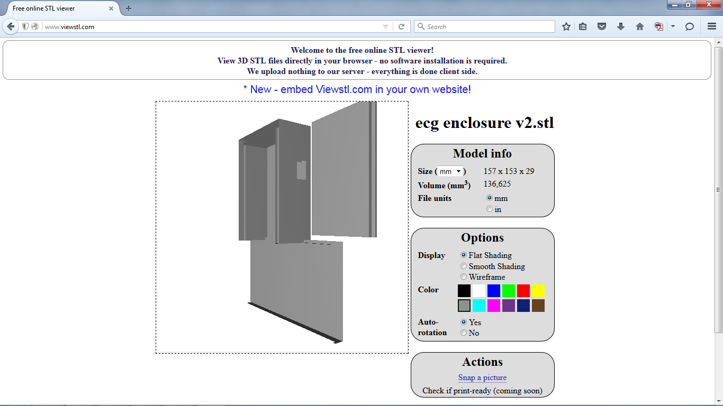
Checking Your STL File For Errors
Dyson Centre
For Engineering Design
A quick check of STL files can be done with a viewer
  E.g. go to www.viewstl.com and drag/drop (or upload) your (<35MB) STL file.
Maybe something odd going on here and here
Version 2 of file!

Slide 17
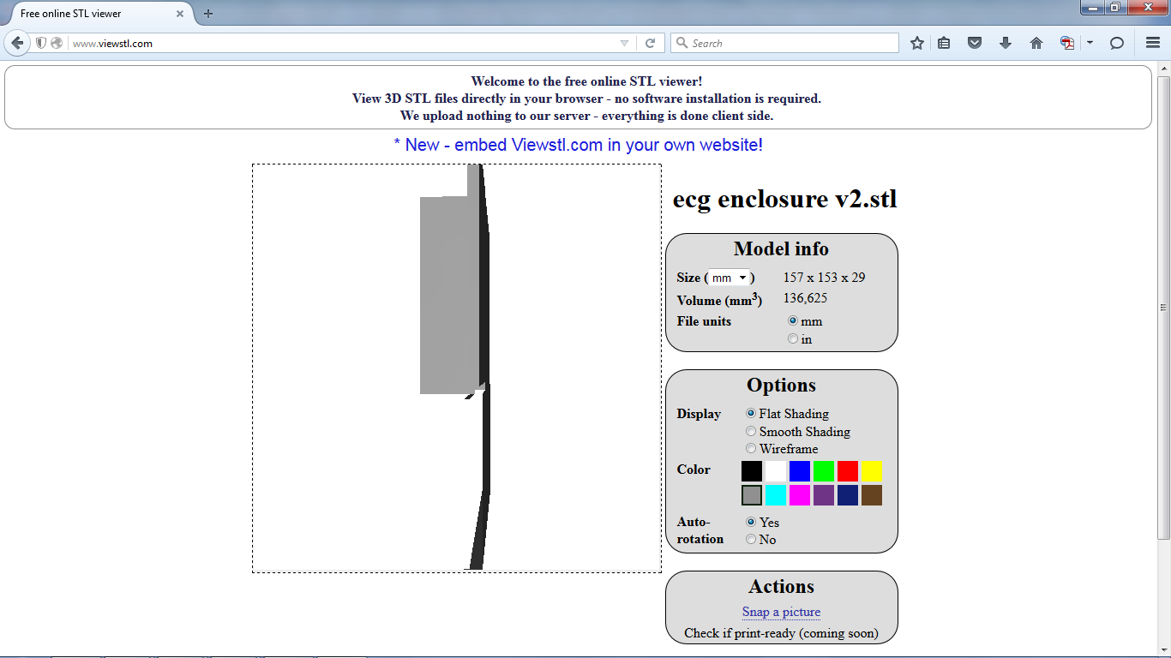
Checking Your STL File For Errors
Dyson Centre
For Engineering Design
A quick check of STL files can be done with a viewer
  E.g. go to www.viewstl.com and drag/drop (or upload) your (<35MB) STL file.
Definitely a problem here.
The thin horizontal surface has vanished when viewed from this side!!!
Version 2 of file!

Slide 18
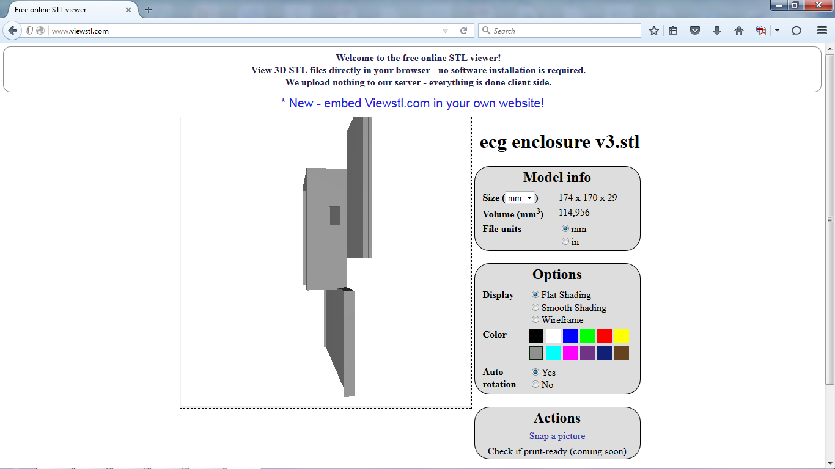
Checking Your STL File For Errors
Dyson Centre
For Engineering Design
A quick check of STL files can be done with a viewer
  E.g. go to www.viewstl.com and drag/drop (or upload) your (<35MB) STL file.
This user then re-exported their STL file using different settings, and the problem seems fixed in this view.
Note: it takes seconds to check in this way.
The file won’t print properly with ‘issues’ so tends to waste a few hours of printing time.
Version 3 of file!

Slide 19
Checking Your STL File For Errors
Dyson Centre
For Engineering Design
A quick check of STL files can be done with a viewer
  E.g. go to www.viewstl.com and drag/drop (or upload) your (<35MB) STL file.
Also important to keep an eye on the size of your model: the IdeaWerk machine can print at most 150mm x 150mm x 140mm high.
Note that you can print long thin parts diagonally if that helps.
In this case, we could scale down the size of the part (see later on using DoreWare-P).
Note that excessive scaling down can reduce part thicknesses beyond what is practically printable/durable.
Version 3 of file!

Slide 20
Processing Your STL File For the 3D Printer
Dyson Centre
For Engineering Design
Online part source, such as Thingiverse
WTK File to IdeaWerk Machine
CAD Package
STL File Checker
Checked
STL File
STL File Processor
Unchecked STL File

Slide 21
Processing STL Files
Dyson Centre
For Engineering Design
To process the STL file into a WTK file which can be fed into the IdeaWerk machine, we use a package called DoreWare-P.
You can install this on your own PC at your own risk from:
www.dysoncentre.eng.cam.ac.uk/doreware
or it is installed on the machine/s indicated near the 3D printers.
The software takes the arrangement of triangles in 3D space, which represent your surface/s and turns them into instructions for making 2D layers.
Instructions for such machines (including CNC milling machines) is known as G-code, which is instructions such as move X by so many millimetres, or move in an arc in the XY plane, centred on this point, etc.
DoreWare-P modifies the G-code slightly into a WTK file format. Other 3D printers have other file formats (such as .makerbot, etc).

Slide 22
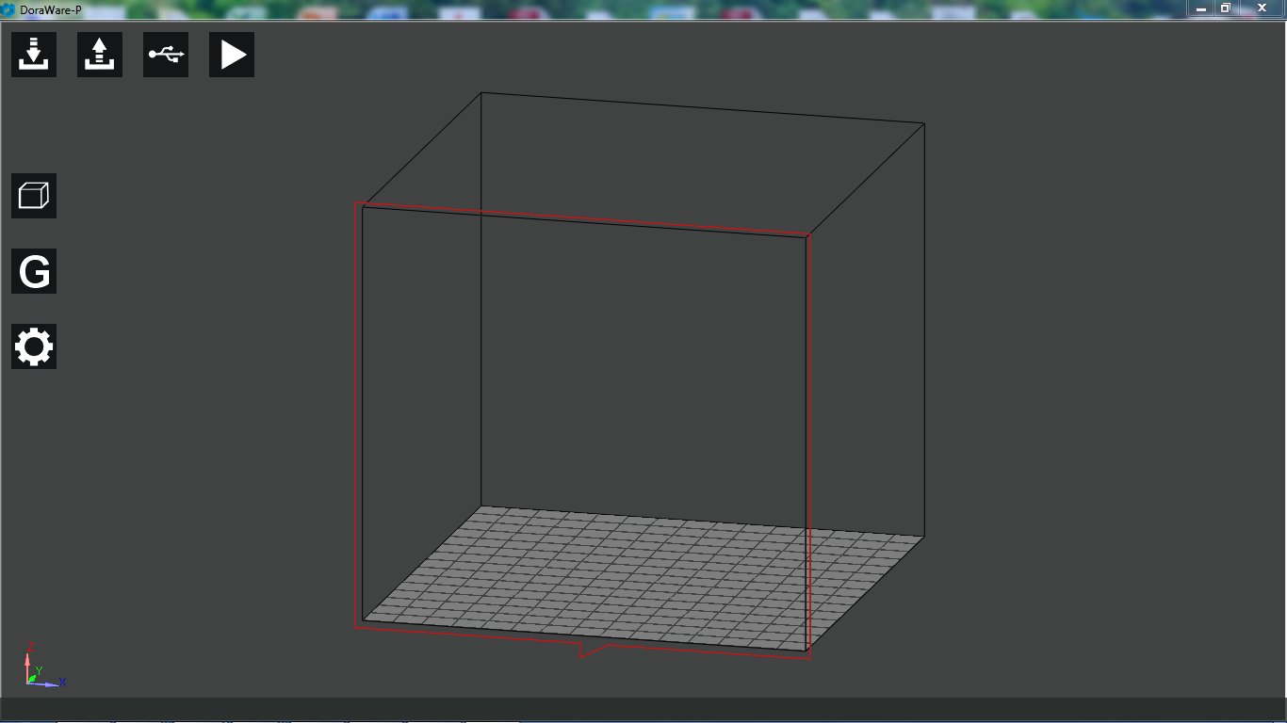
Loading STL File into DoreWare-P
Dyson Centre
For Engineering Design
Use this button to import your STL file

Slide 23
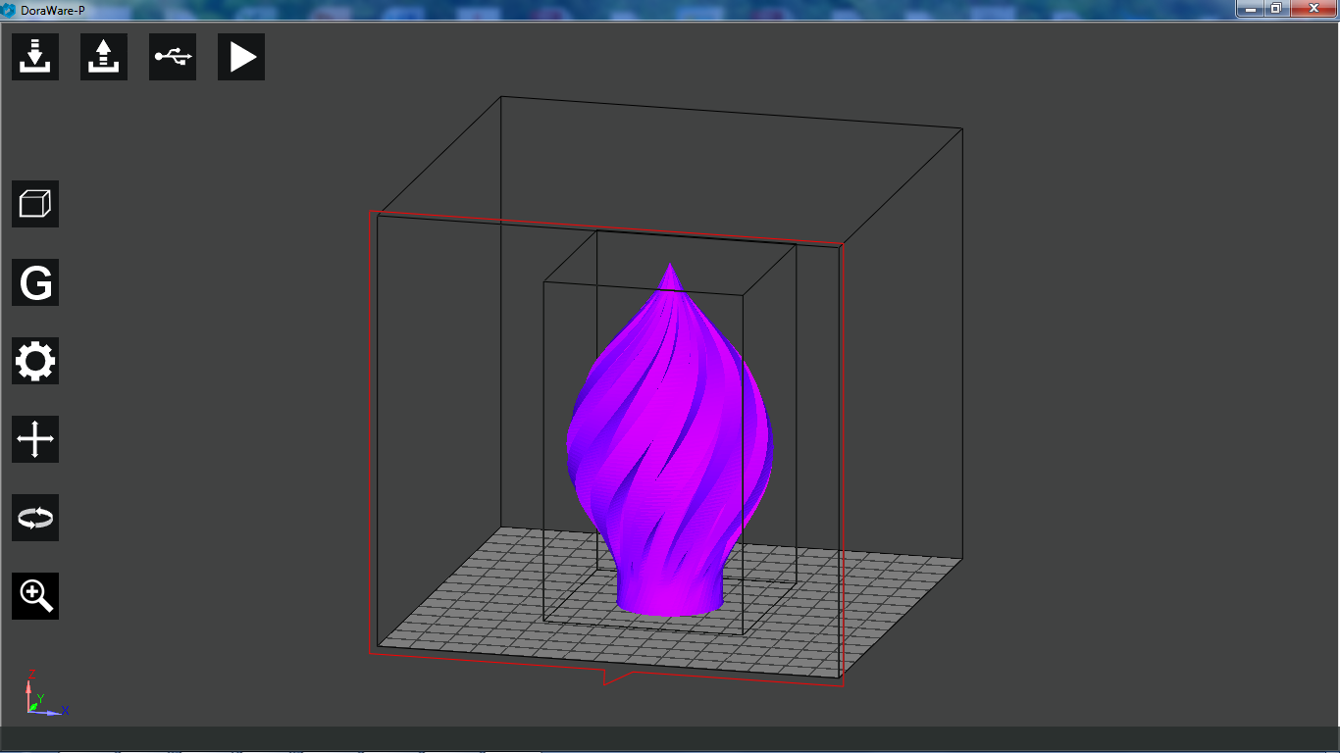
Manipulating Object in DoreWare-P
Dyson Centre
For Engineering Design
Purple means it will fit within what the IdeaWerk machine can print.
Green means that is it outside of this space and may need scaling down, or may just need relocating, or maybe both.
Manipulate the
object (you may
need to click on
your object first
to make symbols
appear) using…
x, y, z translations
x, y, z rotations
scaling – all axes
simulatanously
…or if you made the object yourself, if may be easier to do more specialist ‘tweaks’ in the original drawing package.

Slide 24
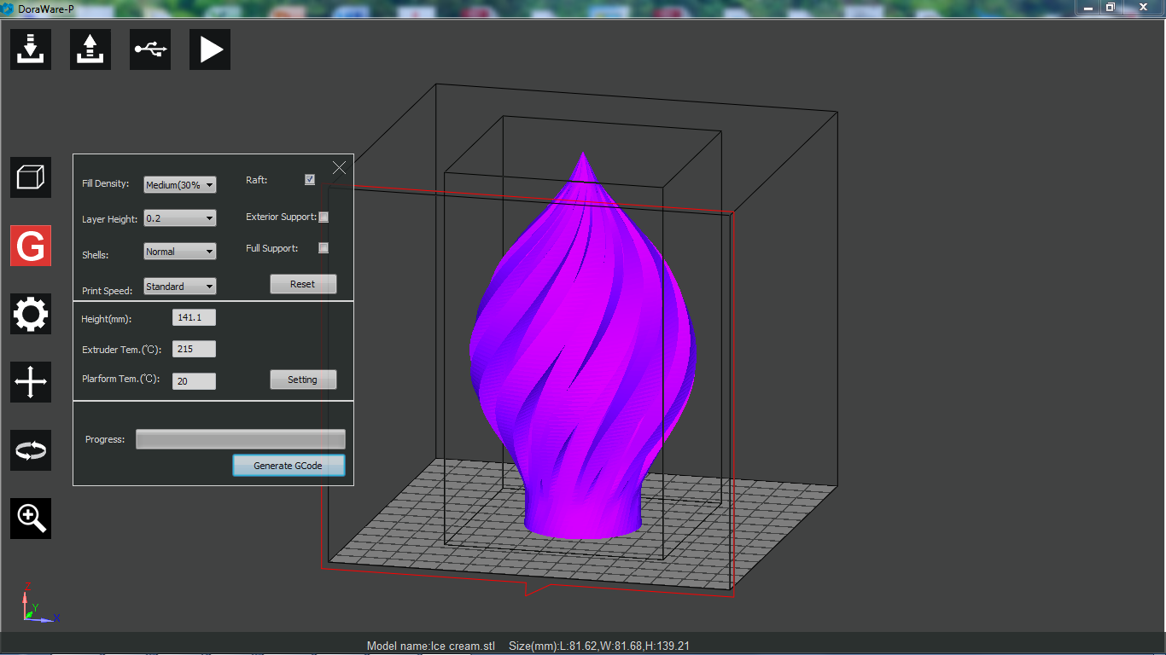
Producing G-Code in DoreWare-P
Dyson Centre
For Engineering Design
When you’re ready to start producing G-code for your item, click on G and the above option interface will open.

Slide 25
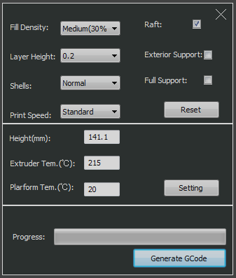
Producing G-Code in DoreWare-P
Dyson Centre
For Engineering Design
3D printed objects are rarely solid – the consist of a honeycomb centre and a solid shell.
“Fill density” allows you to vary the amount of material in the honeycomb.
“Shells” enables you to vary the thickness of the solid shell.
What to pick will vary a little depending on what you want the part for, but the default setting for both is not a bad start point.

Slide 26
Producing G-Code in DoreWare-P
Dyson Centre
For Engineering Design
How thick a layer (in mm) the printer tries to lay down at once, and how fast it is traversing will have an effect in print quality.
0.2mm and standard print speed seem to produce good results, as do faster and thicker settings for crude items.

Slide 27
Producing G-Code in DoreWare-P
Dyson Centre
For Engineering Design
Raft produces a layer under your item, which helps it to stay stuck to the print bed, whilst the item is being printed.
It will easily peel away from your item, and we do not recommend you untick this option!
The raft also helps to compensate for any misalignment and/or irregularity in the bed.

Slide 28
Producing G-Code in DoreWare-P
Dyson Centre
For Engineering Design
“Support” refers to temporary (break away) vertical columns which the printer prints under your item, to help the printer print runs of material which would otherwise constitute it trying to lay down molten plastic in mid air, which wouldn’t work.
Our two options here are
  Exterior support (i.e. underneath it, between it and the bed/raft).
  Full support (where all overhangs further up are also supported.
(Note you can’t tick exterior and full support, as exterior support is a subset of full support.)
Raft Only (self supporting design!!!)
Raft + exterior support
Raft + full
support
Trying to print green item. Support shown orange.

Slide 29
Producing G-Code in DoreWare-P
Dyson Centre
For Engineering Design
Setting the [maximum?] height of the model doesn’t seem to have much point, unless you have a modified machine.
For PLA printing set the extruder temperature to 220 deg C.
For PLA printing: set the platform temperature to 70 deg C if your item if more than about 4cm in diameter, otherwise you could leave it at 20 deg C.
This avoids shrinkage causing larger items to warp off the bed during printing.
Note we will also enter the same temperatures into the machine to avoid an issue with the way in which it operates.

Slide 30
Producing G-Code in DoreWare-P
Dyson Centre
For Engineering Design
Click to generate the G-code.
Note that this is computationally fairly complex.
Time taken may vary from a few minutes for something simple…
…to about half an hour for the example item shown six slides ago, with no support…
…to a few hours for a very complex piece – the progress bar is a useful indicator something is happening
Note that we have yet to have positive results at this stage from combining multiple STL files together, so we suggest you combine STL files together outside DoreWare-P, or produce a single STL from your drawing package.

Slide 31
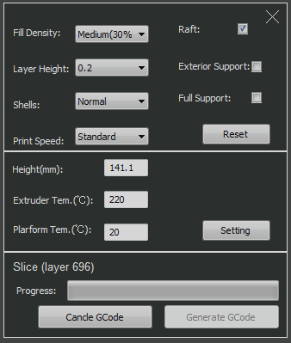
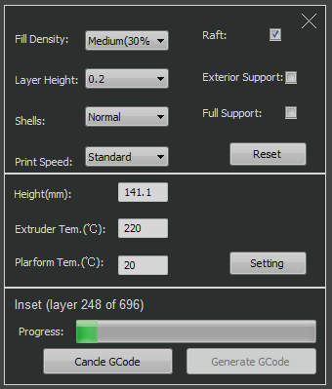
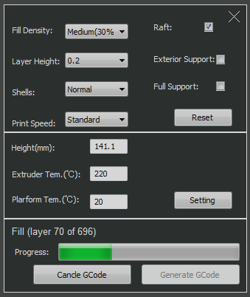
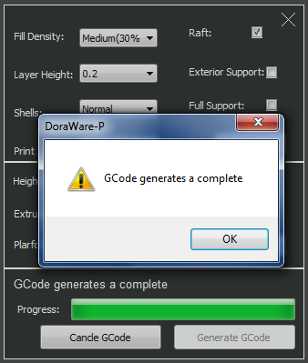
Producing G-Code in DoreWare-P
Dyson Centre
For Engineering Design
A few shots whilst waiting for the G-code.
..and when we get the message above, we know the G-code has been finished.
Click “OK” in the box, click the “X” in the top right of the G-code window.

Slide 32
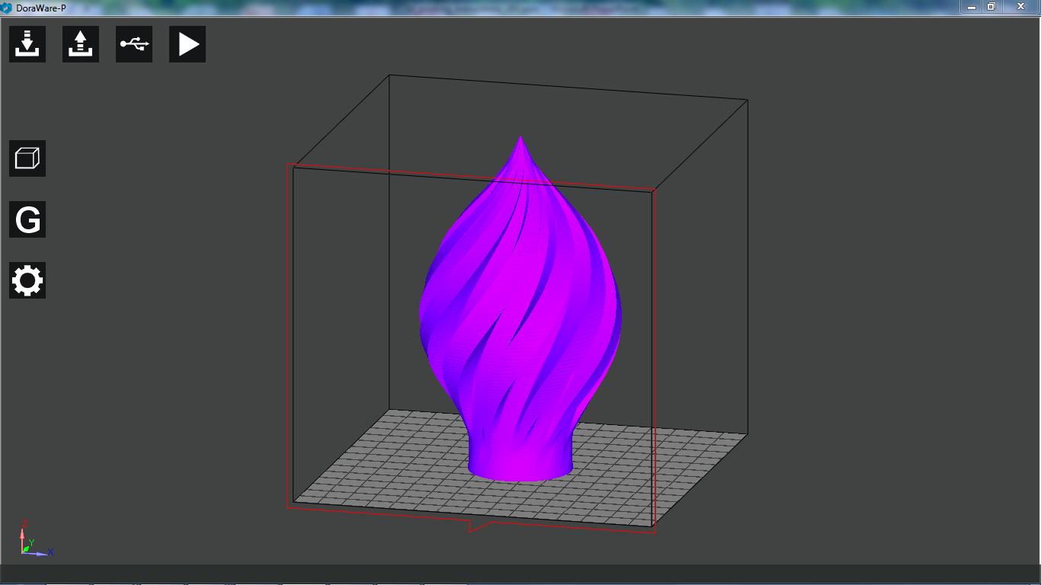
Producing a WTK File from DoreWare-P
Dyson Centre
For Engineering Design
Use this button to export a WTK file to a USB memory stick
Note there are some peculiar requirements and restrictions:
Memory stick not larger than 32GB
WTK file must be in a directory called 3DMODEL, and this directory must not be within any other directory.
The model name of the WTK file before the .WTK must be no more than 8 characters long: e.g.
E:\3DMODEL\Richitem.WTK fine
E:\3DMODEL\Richardsitem.WTK won’t work
The printer can recognise no more than 58 model files on the stick and better to have maximum 20.
Not clear of the effect of other content on the stick, and if it might/could corrupt it! (I.e. suggest a dedicated stick.)

Slide 33
Printing the WTK File from the USB Stick
Dyson Centre
For Engineering Design

Slide 34
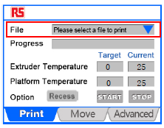
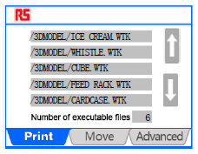
Setting the Printer Up From Its Touch-Screen
Dyson Centre
For Engineering Design
Ensure the printer is switched on at the wall and at the switch on the rear of the printer. Also that a brown/black bed is clipped with four clips to the aluminium platform.
Check that the printer is loaded with the correct filament that you want to use (both type of plastic and colour) – if not please ask for help in changing it, or see if you can find a printer which is correctly loaded.
(If helpful we’ll add a few sheets on changing filament in the future.)
Insert your memory stick into the printer.
On the ‘Print’ tab, use the blue triangle and then the up and down arrows to get to the WTK file you want to print – touch the file to select it.
Note carefully the formal of the screen: Extruder and platform temperatures, and target and current temperatures.!

Slide 35
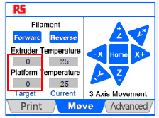
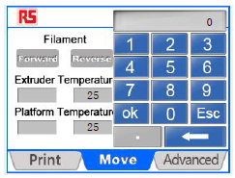
Setting the Printer Up From Its Touch-Screen
Dyson Centre
For Engineering Design
Now select the ‘Move’ tab.
On this page I would set the extruder and platform temperatures again, even though you already set them in the G-code. The reason for this is that if a previous user has set them in the ‘Move’ tab, then the G-code setting will be over-ridden!
Tap on the target temperature to alter it – you’ll be provided with a numerical pad to enter the target temperature.
Remember for PLA, extruder 220degC and platform either room temperature or 70degC for anything over about 4cm in diameter.
Now select the ‘Print’ tab again.
Observe for about 20 to 30 seconds till you can see that the temperature/s is/are tracking in the right direction.
When you’re happy, start the print using the ‘Start’ button on the ‘Print’ tab (if heat up it will tell you).
Note that for the item we considered in Doreware-P, that would probably take around 8 hours to print!
Note we are happy to leave the machines running overnight, but please see safety notes at end of slides

Slide 36
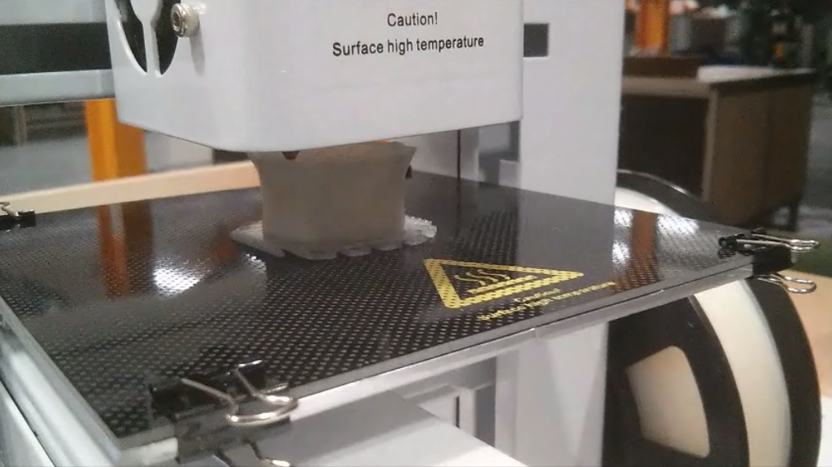
What the Printing Process Should Look Like
Dyson Centre
For Engineering Design
Note black bed and four clips!

Slide 37
When the Printing Has Finished
Dyson Centre
For Engineering Design
When the printer finished, it will drop the bed down to the lowest position and start cooling down…you may want to touch the touch screen (to wake it up) and see what the current temperature of extruder and platform are.
Note that they should be cooling down – if not, set them to zero in the ‘Move’ tab and go back to the ‘Print’ tab. If they still aren’t cooling down, ask for help or switch the printer off at the wall.
(Note that throughout the print you can touch the touch-screen to wake it up and see what the percentage progress is – it is suggested you time the first percent or so to work out how long you think it will be till the job is finished.)
When you are happy the bed is cool enough (so as not to burn you, but ALSO so that your component isn’t still soft and pliable) unclip the four clips and remove the bed.
When the printed item is cooled to room temperature, it should be possible to pull it off the bed, or gently flex the bed slightly if need be, taking care not to permanently bend it.
Please then replace the bed and clips.
Don’t forget to pay what is owed for the cost of materials – see next few slides.

Slide 38
Charging
Dyson Centre
For Engineering Design
We have funds to buy 3D printers for undergraduate use.
We do not (yet) have funds to buy materials, so we ask you to pay for these, but the cost is relatively low.
We do not have funds to pay for 3D printing for research, except for 4th year projects (or have enough printers for this additional use) , if you are a postgraduate/post-doc researcher or a member of staff reading this – please contact the Dyson Centre Manager to discuss further.

Slide 39
Charging: RS/IdeaWerk Machine
Using Standard PLA
Dyson Centre
For Engineering Design
For the above combination of
  Machine
  Material
Please use the electronic scales to work out the mass of PLA used
  Do include any scrap
  Rafts, supports
  Failed attempts (these are at your cost)
Charge is £1 per 30g of part there-of.
  Ie 25g is £1, 40g is £2, 60g is £2, 61g is £3
For the time being please see the Manager to make payments and ensure you get a receipt.
We will try to streamline the payment process in the future.
Note: all 3D printing filament payments will go into a dedicated account intended for buying more filament.

Slide 40
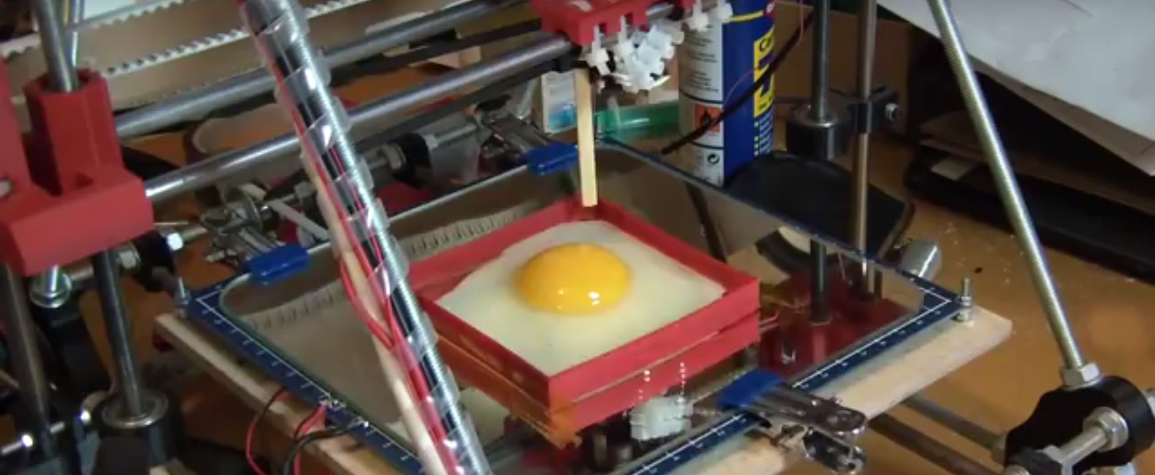
Health and Safety
Dyson Centre
For Engineering Design
Egg visibly cooking after just 5 seconds on a 3D printer bed.
Taken from https://www.youtube.com/watch?v=gD59u5WafmQ
As with many such machines in workshops, these machines are not default safe to use - you can cause harm to yourself and others and to the machine if you don’t understand how to use it correctly.
An appreciation of the risks and what to do about them is important.

Slide 41
Health and Safety: Burned!
Dyson Centre
For Engineering Design
What could go wrong?
  Could get burnt by extruder or by molten plastic coming out of it – usually between 200 and 280deg C (significantly hotter than boiling water!!!):
  Don’t touch extruder, or molten plastic coming out of extruder, even if it looks cool.
  Could wear protective gloves (need to be sufficiently insulating).
  Make sure you know where nearest sink is and get burns under cold water promptly and keep them there for 10 to 20 minutes!
  Also seek help from a first aider – ask at reception if you can’t find one, or if outside normal hours, call security on 31818 from the phone on the Manager’s desk, or 01223 331818 on your mobile phone. Further details at Manager’s desk.

Slide 42
Health and Safety: Burned Again!
Dyson Centre
For Engineering Design
What could go wrong?
  Could get burnt by the platform/bed or item recently printed: if the bed is still being heated, it could be around 100 deg C (ie as hot as boiling water!!!):
  Don’t touch bed until you are sure it has cooled down – touch screen will tell you current temperature (be careful not to get mixed up with target temperature or same for extruder/nozzle).
  Be cautious when moving to handle the bed or the item printed.
  Also see advice on previous page about: gloves, treatment of burns and summoning of a first aider.

Slide 43
Health and Safety: Trapped!
Dyson Centre
For Engineering Design
What could go wrong?
  Could get trapped above or below the moving [heated] bed and/or the moving [heated] extruder head.
  Stay clear of the moving parts!
  If you do get trapped:
  turn the power off, which should allow you to move the bed and/or extruder head to free yourself.
  Seek a first aider if you are inured in any way, as per two slides ago.
  If you have been burnt by the hot bed and/or extruder head, follow advice from two slides ago for dealing with burns and summoning a first aider.

Slide 44
Health and Safety: Gassed!
Dyson Centre
For Engineering Design
What could go wrong?
  Harmful gases coming from extruder from heating non-standard materials
  Or from overheating standard materials.
  Double check target and actual temperature of extruder.
  Double check what material is being used.
  Ask for advice if printing a non-standard material.
  If you do think you have been exposed to potentially harmful gases, summon a first aider as per three slides ago.

Slide 45
Health and Safety: On Fire!
Dyson Centre
For Engineering Design
What could go wrong?
  As the extruder is above the auto-ignition temperature of things like paper, there is a change of the machine easily being able to start a fire.
  Keep the area free from paper, and any other debris.
  If realistically possible, stay with the printer whilst in use, or monitor it using the webcams which will shortly be provided.
  If you do find a fire:
  (1) immediately raise the alarm.
  (2) if safe to do so, use a fire extinguisher to try to put the fire out, and if possible disconnect the printer from the mains (assuming the electricity cables aren’t now damp)
  (3) if in doubt, leave the building and raise the alarm.
  (4) be careful of breathing in any fumes from the fire.

Slide 46

Happy 3D Printing!
Dyson Centre
For Engineering Design
(Do sleep safe and don’t have nightmares!)
Hopefully this is helpful in getting you started. If you do have any questions of comments, then please feel free to ask, either in person or via email to: dyson-manager@eng.cam.ac.uk
With kind regards,
Rich.

