Slide 1
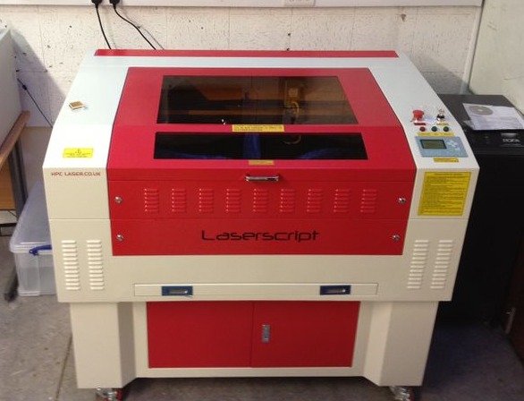
An introduction to using HPC Laser Cutter
Dyson Centre
For Engineering Design
By Diana Thomas-McEwen
Notes:
Here:
Who we are Rosie Lauren Silke
Point of talk

Slide 2
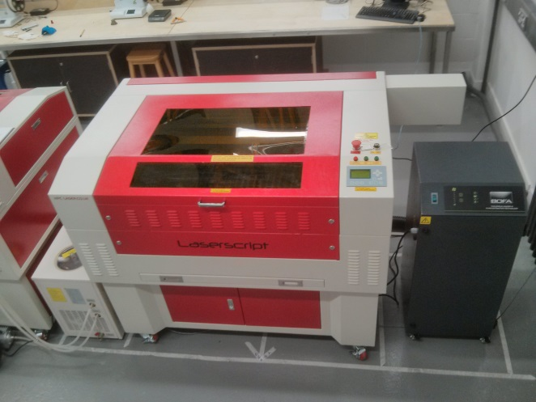
Machine Familiarisation
Machine Front
Laser cutter lid on top - needs to be lifted to insert and remove materials
Control panel
Fume extraction and filtering unit
Automatic water-based cooler
Dyson Centre
For Engineering Design

Slide 3
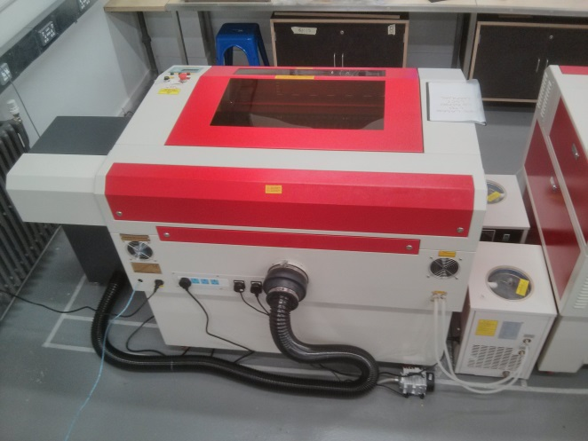
Machine Familiarisation
Machine Back
Lockable covers at the rear of the laser cutter (these should be left locked to avoid exposing the laser tube).
A small air compressor unit can also be seen on the floor.
Dyson Centre
For Engineering Design

Slide 4
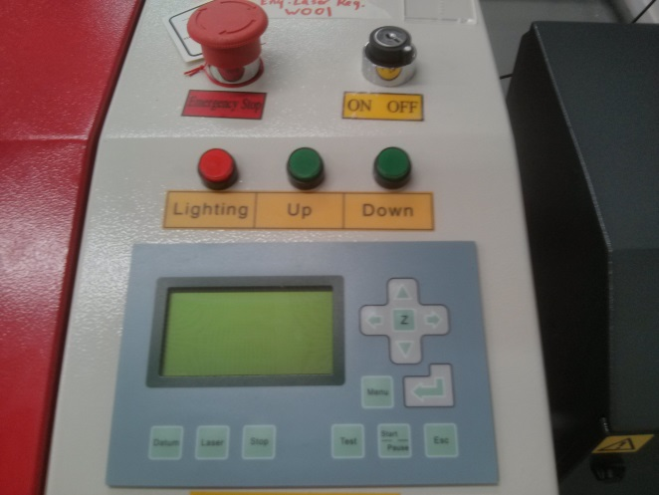
Machine Familiarisation
Laser Cutter Controls
Emergency stop
key lock
Laser focus control buttons
Control key pad
Dyson Centre
For Engineering Design

Slide 5
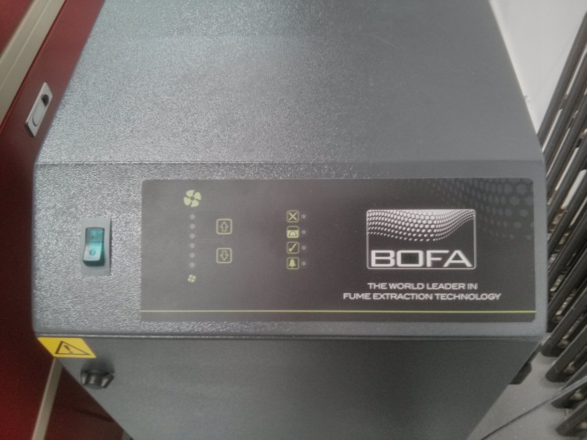
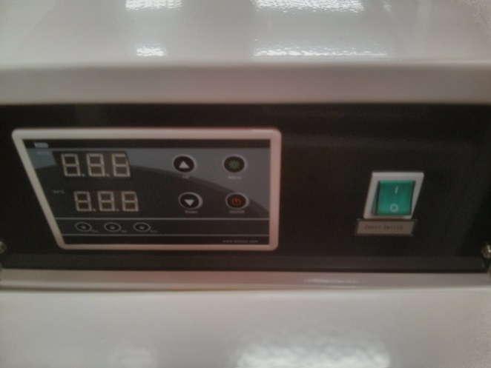
Machine Familiarisation
Extractor fume unit and Water based–cooler unit
The fume filter unit control panel
Water-based cooler unit control panel
Dyson Centre
For Engineering Design

Slide 6
Using LaserCut 5.3 Software
Dyson Centre
For Engineering Design

Slide 7
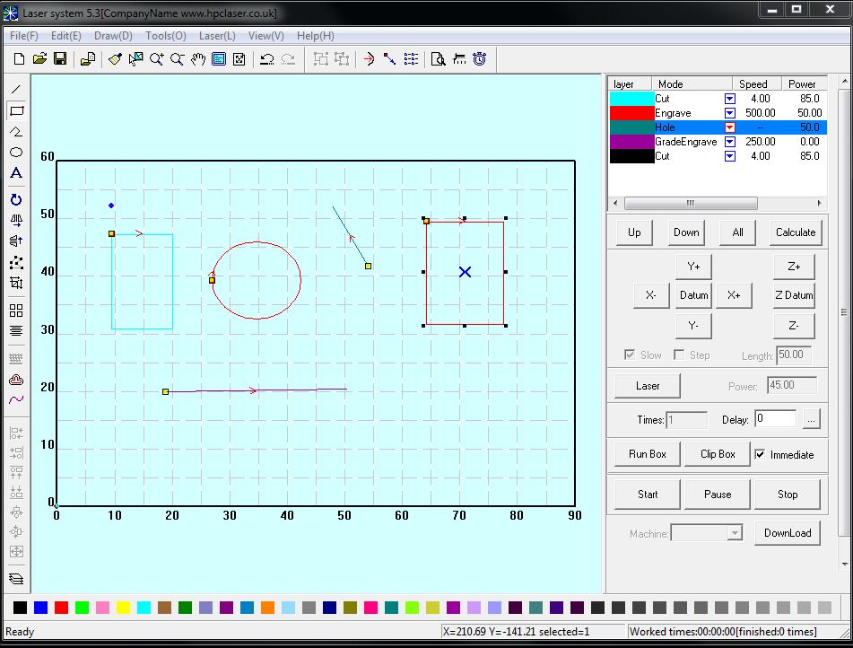
Using LaserCut 5.3 Software
Familiarisation with software interface
File Toolbar
Output Toolbar
Layer order panel
Edit Toolbar
Control panel
Align Toolbar
Work layer Toolbar
Status bar
Dyson Centre
For Engineering Design

Slide 8
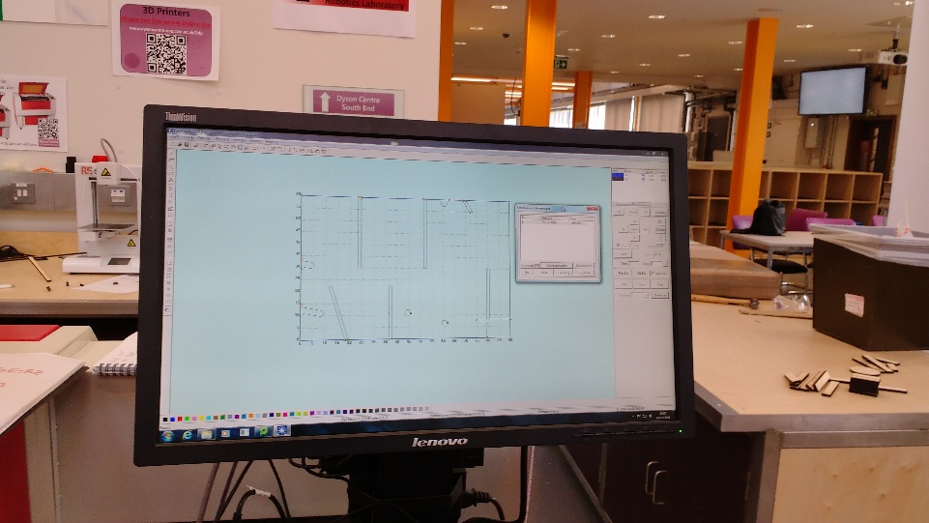
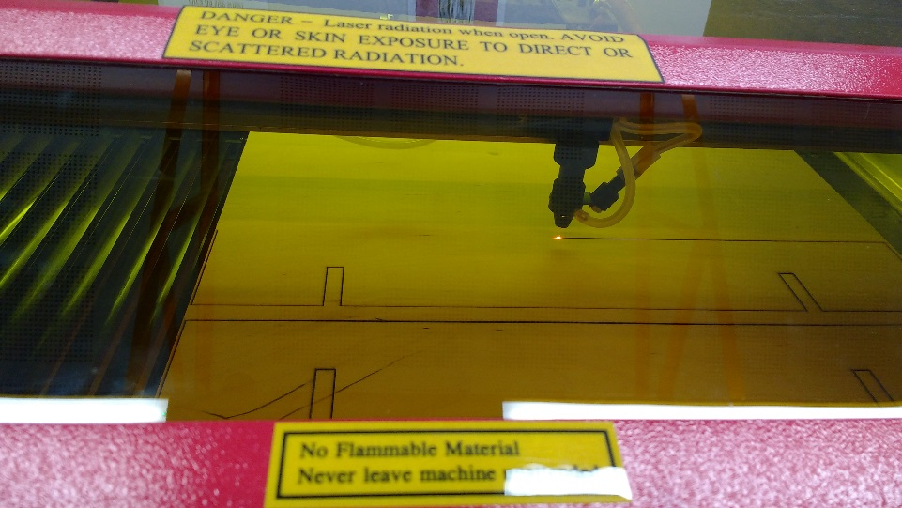
Using LaserCut 5.3 Software
Importing file into Lasercut 5.3
Formats including *.PLT、*.AI、*.DXF、*.DST、*.BMP、NC code etc
No duplicate lines
Select file to import click
Select ‘Unite lines’ so each polyline is connected to the next
Dyson Centre
For Engineering Design

Slide 9
Using LaserCut 5.3 Software
Creating a file from scratch in Lasercut 5.3
This simple program is limited in what it can do listed below are some of its functions:
  New file
  Save/save as (*.ecp）
  Tools
  Layer properties
  Data check (check the data to make sure it is closed)
  Smooth curve
  Unite lines
  Offset curve
  Define first cut (specify where the first cut should be made)
  Simulate operation time
Dyson Centre
For Engineering Design

Slide 10
Using LaserCut 5.3 Software
Creating a file from scratch in Lasercut 5.3
Specific Draw Functions
  Line, Rectangle
  Multipoint
  Ellipse
  Bezier Curve
  Text (single line text, however previews of the text are not shown)
  Array
  Rotate
  Mirror
  Size (will not set X and Y in relation have to be set separately.)
  Group
  Align
Dyson Centre
For Engineering Design

Slide 11
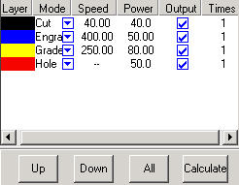
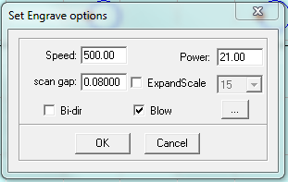
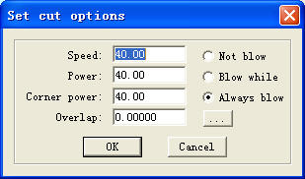
Using LaserCut 5.3 Software
Setting up LaserCut 5.3 to cut
Main Interface of Layer Management
Use the up and down arrow to set the layer order.
Interface of Set cut options
Double click the colour identification bar to select the power and speed that each
of these cuts should be made at.
Dyson Centre
For Engineering Design

Slide 12
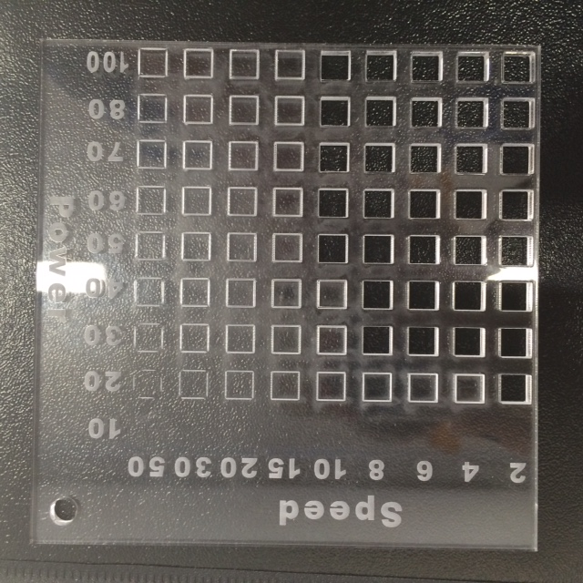
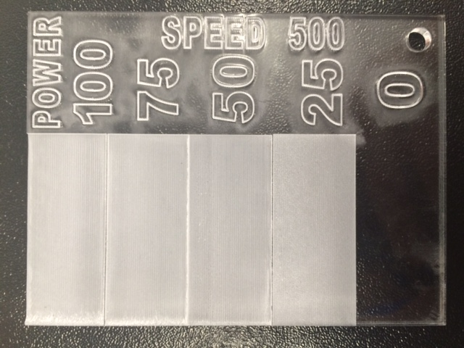
Using LaserCut 5.3 Software
Setting up LaserCut 5.3 to cut
Use the cut and engrave mock ups to decide on the power and speed
Cut
Engrave
Dyson Centre
For Engineering Design

Slide 13

Layer management
Cutting/Engraving
Before downloading check the settings for each layer in the layer manager
Check:
  Layers order to be cut or engraved.
    The top one will be cut/engraved firth
  Power and speed
  Check that material is square to on the bed
  Make sure the extractor and the cooler are both on
Cut
Dyson Centre
For Engineering Design

Slide 14
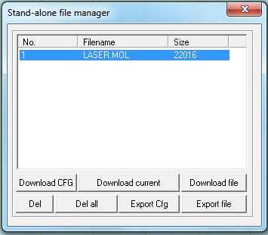
Download
Download data
Once completed download the design to the laser cutter MPC6515
Download current file - Download the current processing data displayed
Download file - Download processing data to MPC6515 controller.
Del - Delete the file which is selected.
Del all - Delete all the files in MPC6515 controller.
Export Cfg - This will create a *.mol file which includes all the parameters of “Options”. The file can be downloaded to MPC6515 controller by USB disk.
Export file - This will create a *.mol file which includes all the parameters of a processing data. The file can be downloaded to MPC6515 by USB disk.
Cut
Engrave
Dyson Centre
For Engineering Design

Slide 15
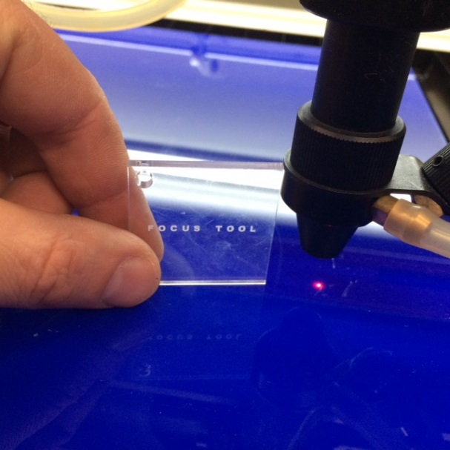
Laser Focus, Positioning, Test and Cut
Laser Focus
To create a clean, fine cut the laser need to be set to certain distance from the material
Ensure that all covers to the machine are closed, and the lockable covers are locked
Turn on the Laser cutter using the key.
  Leave to run for 5 minutes before cutting anything,
Position the material to be cut on the bed.
Position the laser in the middle of the material.
Move the bed up/down focus the laser using the focus tool
The laser is now in focus and ready to cut.
NOTE: Can only download the file to the Laser cutter once it is turned on.
Cut
Engrave
Dyson Centre
For Engineering Design

Slide 16

Laser Focus, Positioning, Test and Cut
Positioning and test
Positioning the laser on the material
The area that the design covers will be traced out in a rectangle using this function.
Using the arrow buttons on the control key pad position the laser.
Select ‘test’ in the control keypad.
The laser head will then move (not cutting) tracing the area that design will fit into one rectangle.
Once set so the design fits within the material the laser can be set to cut.
WARNING: Once the laser has been set to cut you CAN NOT leave the laser unattended, as a fire could start in the machine.
Cut
Engrave
Dyson Centre
For Engineering Design

Slide 17
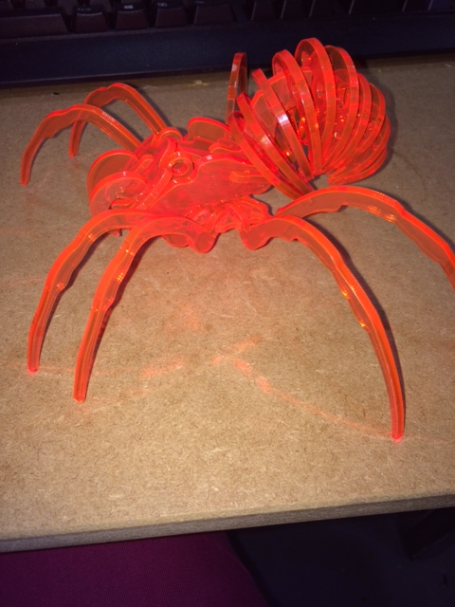
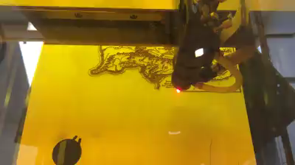
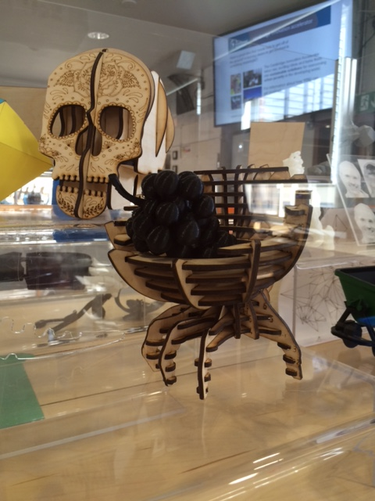
Laser Focus, Positioning, Test and Cut
Cutting
The red dot laser shows the position of the laser as it is cutting.
The speed and power of the laser have been set in the lasercut 5.3 software
Wood lower power
Cut
Dyson Centre
For Engineering Design

Slide 18
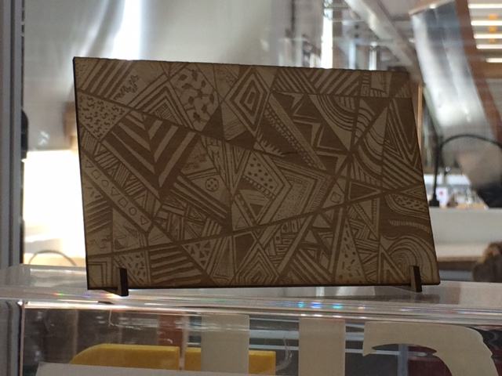
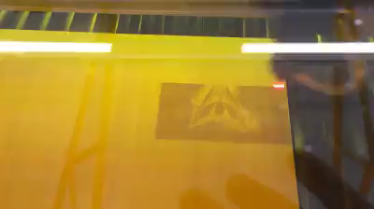
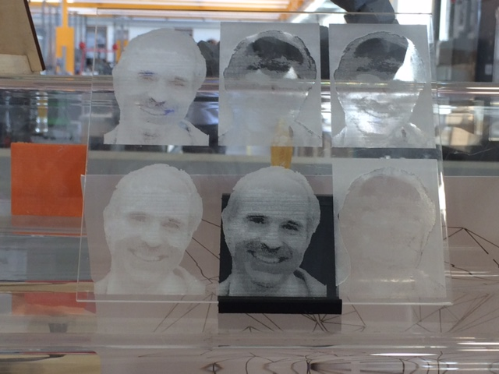
Laser Focus, Positioning, Test and Cut
Engraving
The laser scorches the wood engraving in a printer like fashion
The image/ design can be inverted to be shown like a photo negative.
The design has to be in BMP format with no colour to ensure the design can be read by the laser cutter
Cut
Dyson Centre
For Engineering Design

Slide 19

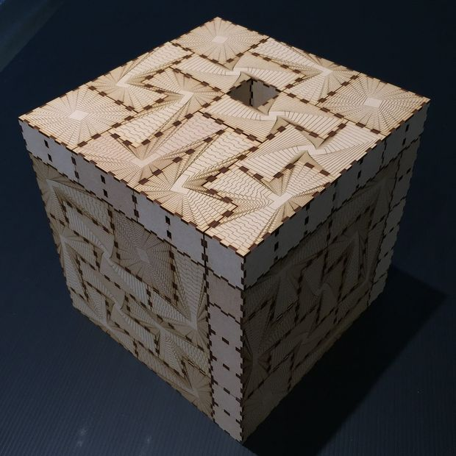
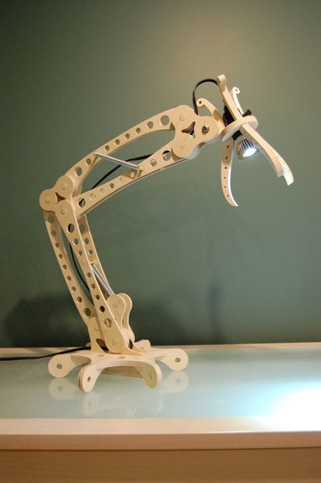
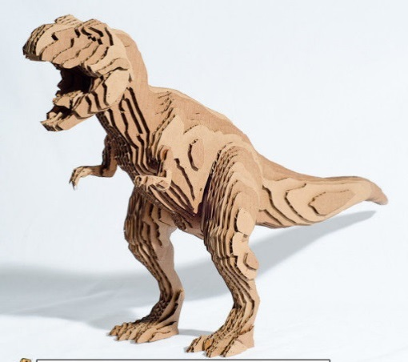

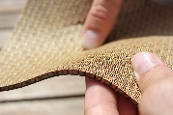
Inspiration and Design
Inspiration
Web resources such as Thingiverse, Instructables
Design
By designing and share the DXF of the design
Can be design in all types of software
Cut
Dyson Centre
For Engineering Design

Slide 20
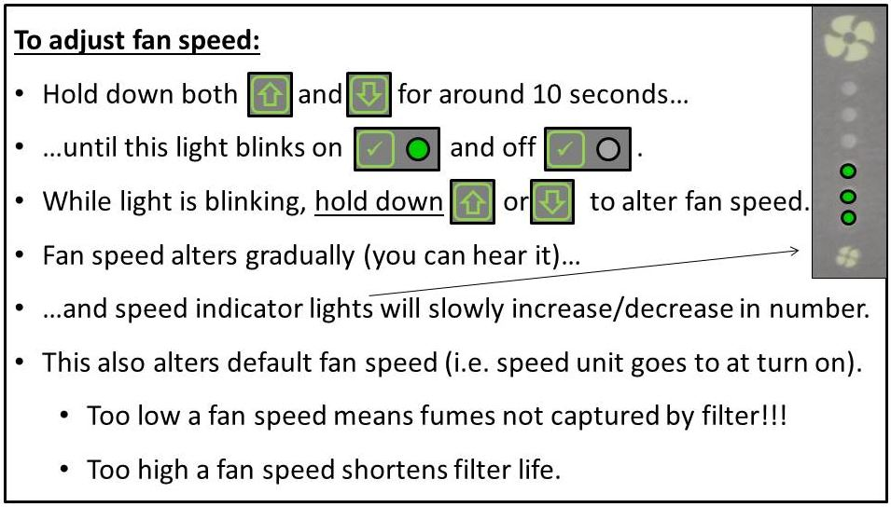
Information and Safety
Adjusting the Fan speed
When cutting material the fan speed may need to be increased or descrease
NOTE: If the smell of burnt material is strong increase the fan speed more via the instructions.
Suggest a fan speed of min 3 lights.
Cut
Dyson Centre
For Engineering Design

Slide 21


Information and Safety
Safety
Do also beware of the effects on you and the fire alarm of fumes escaping.
Do stop cutting if:
  you feel unwell at all, and seek help, or
  there are any unexpected smells in the air.
  fire starting
Leaving the cover down for a few seconds longer to ensure fumes have been removed by the extractor.
Risk assessments understood.
Cut
CHLORINE
CHLORINE
CHLORINE
CYANIDE
TOXIC GAS
Dyson Centre
For Engineering Design

Slide 22
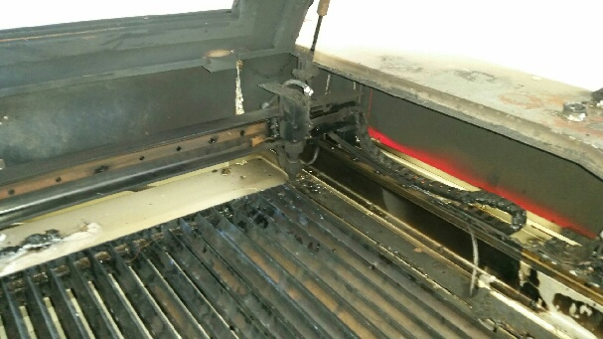

Information and Safety
Laser cutter Safety Rules
PLEASE DO NOT
  leave the machine running unattended
  disassemble the machine or remove any of its protective covers
  interfere with the door interlocks
  look directly at the red laser dot
  make or break any electrical connections to the system
  use combustible materials, volatile solvents such as acetone / alcohol
  attempt to cut ANY metal
  look directly at the ‘cutting point’
  cut any items containing PVC or Vinyl
FLAMMABLE
CHLORINE
Dyson Centre
For Engineering Design

Slide 23
Information and Safety
Laser cutter Safety Rules
PLEASE MAKE SURE
  the dust/fume extractor and air assist compressor is turned on when cutting
  keep the laser bed clean and remove any small cuttings from the draw below)
  seek a member of staff if you are unsure of any procedures
  the area around tidy and clutter free
  have a fire extinguisher nearby.
Dyson Centre
For Engineering Design

Slide 24

Materials
Charge forms and in house materials
Laser cutter material are sold in the Dyson building
Lacerable material can be brought in to be used but proof of the what the materials is, is needed.
Once finished please fill in a charge form and hand in to the Dyson centre managers desk
All prices for materials can be found on the wall near the laser cutters
If requested materials can be ordered in and paid at cost price
No profit is made, all the materials are sold at cost price.
Can Cut Wood, Acrylic, Paper, Card. Can Engrave Glass and Slate
Dyson Centre
For Engineering Design

Slide 25
Laser Cutter Training
Training is now being offered so that the laser cutter can be used with out being supervised.
Dyson Centre
For Engineering Design

