Slide 1
Hydrogels
Emilie Pauwels
Dyson Day

Slide 2
What are hydrogels?
Polymer network forming a gel-like material
Network absorbs a lot of water, swelling in the process, but remaining dry
Some can be up to 99% water
Notes:
Polymers that absorb a lot of water, swelling up in the process
Some may be up to 99% water
Water absorbers. “We made a hydrogel that can absorb 3,000 times its weight in water!”
https://www.snexplores.org/article/explainer-what-is-a-hydrogel
A hydrogel is a biphasic material, a mixture of porous, permeable solids and at least 10% by weight or volume of interstitial fluid composed completely or mainly by water.^{[1]} In hydrogels the porous permeable solid is a water insoluble three dimensional network of natural or synthetic polymers and a fluid, having absorbed a large amount of water or biological fluids.^{[2][3][4]} These properties underpin several applications, especially in the biomedical area. Many hydrogels are synthetic, but some are derived from nature.^{[5][6]} The term 'hydrogel' was coined in 1894.^{[7]}
^{Chemical or physical bonds}

Slide 3
Hydrogel examples?

Slide 4
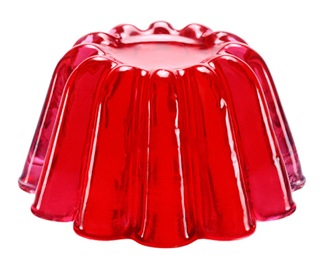
Jelly!

Slide 5
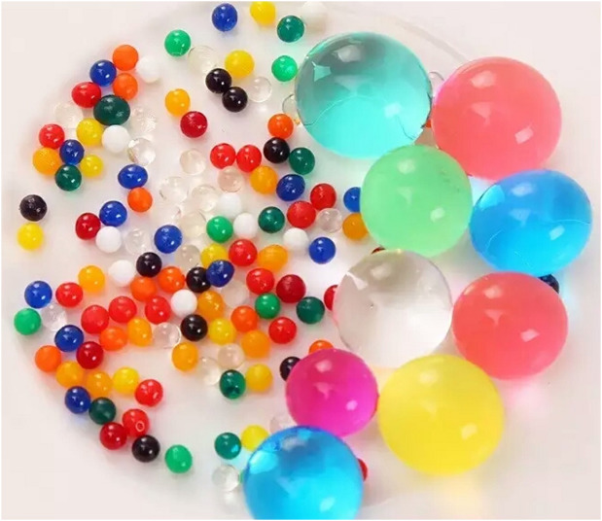
Orbeez
Notes:
For plant watering: Trapped moisture gradually difuses back into soil after plants have been watered
(e.g. over extended time periods)

Slide 6
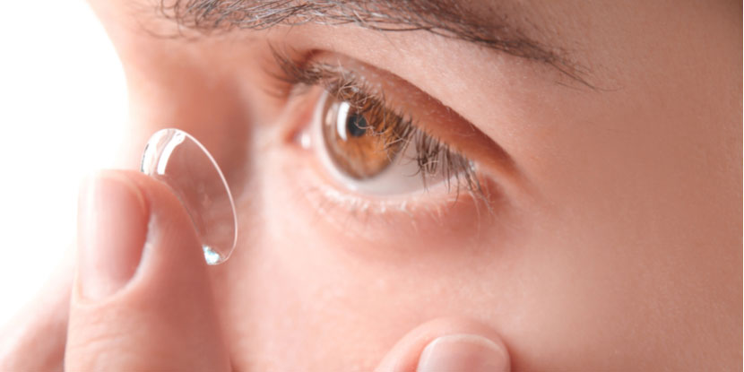
Contact lenses

Slide 7
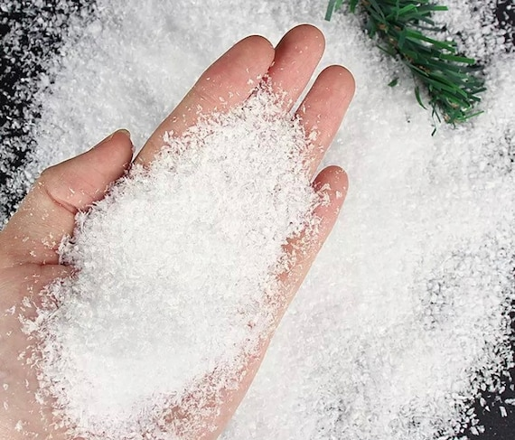
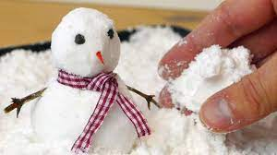
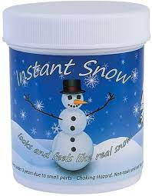
Fake snow

Slide 8
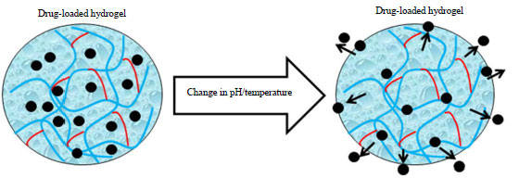
Biomedical devices
Drug delivery
Organ transplants

Slide 9
Hydrogel experiments

Slide 10
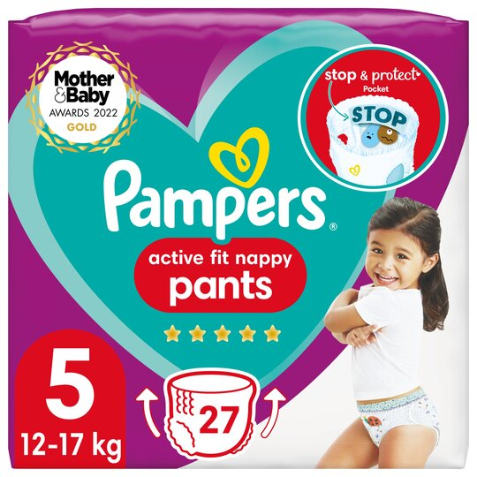
Making a hydrogel
Nappies contain sodium polyacrylate gel
No leaks!
Remove dry hydrogel from nappy and weigh
Hydrate hydrogel by adding water
Weigh hydrogel after maximum amount of water has been added
What observations can you make?

Slide 11
Making a hydrogel
Nappies contain sodium polyacrylate gel
No leaks!
Remove dry hydrogel from nappy and weigh
Hydrate hydrogel by adding water
Weigh hydrogel after maximum amount of water has been added
What observations can you make?
Notes:
No eating
Avoid eyes
Wash hands or wear gloves

Slide 12
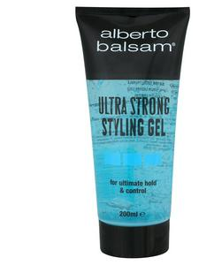
Collapsing a hydrogel
Salt can be used to collapse the hydrogel structure
We will use hair gel
What do you observe?

Slide 13
Experiment time!
Please ask me if you get stuck, have any questions or if you finish early!

Slide 14
Conclusions

Slide 15
Conclusions
Nappy experiment:
Observations?

Slide 16
Conclusions
Nappy experiment:
Observations?
How much water could be added?

Slide 17
Conclusions
Nappy experiment:
Observations?
How much water could be added?
Hair gel experiment:
Observations?
Why?

Slide 18
Conclusions
Nappy experiment:
Observations?
How much water could be added?
Hair gel experiment:
Observations?

Slide 19
How do these experiments work?
Notes:
This experiment will demonstrate one application of hydrogels; this experiment is analogous to the Hair Gel Collapse experiment that can also be found on the website. Ultra-absorbent nappies contain a synthetic polymer that can absorb a vast amount of water; these polymers are known as hydrogels. It is not uncommon for 90% of a hydrogel to be water. This hydrogel polymer works because water molecules are attracted and stick to the polymer chain network; this causes it to swell forming a gel and trapping the water inside.
The trapped water can be released from the polymer chain network by addition of salt to the gel. Ions present in the salt displace the water molecules within the gel because they are more strongly attracted to the polymer than water.
As salt is added to the gel, ions present in the salt are attracted and replace the water in the gel because they are more strongly attracted to the polymer chain that water. As a result of this loss of the water, the gel shrinks and collapses in on itself.

Slide 20
Making a hydrogel
Water is attracted to network, and sticks to chains
Water trapped in the network
Notes:
This experiment will demonstrate one application of hydrogels; this experiment is analogous to the Hair Gel Collapse experiment that can also be found on the website. Ultra-absorbent nappies contain a synthetic polymer that can absorb a vast amount of water; these polymers are known as hydrogels. It is not uncommon for 90% of a hydrogel to be water. This hydrogel polymer works because water molecules are attracted and stick to the polymer chain network; this causes it to swell forming a gel and trapping the water inside.
The trapped water can be released from the polymer chain network by addition of salt to the gel. Ions present in the salt displace the water molecules within the gel because they are more strongly attracted to the polymer than water.
As salt is added to the gel, ions present in the salt are attracted and replace the water in the gel because they are more strongly attracted to the polymer chain that water. As a result of this loss of the water, the gel shrinks and collapses in on itself.

Slide 21
Collapsing a hydrogel
Water displaced by salt
Network collapses
Notes:
Ions present in the salt displace the water molecules within the gel because they are more strongly attracted to the polymer than water.
As a result of this loss of the water, the gel shrinks and collapses in on itself.
Eventually all water molecules replaced

Slide 23
My project using hydrogels

Slide 24
Tedex video?
https://www.youtube.com/watch?v=znSeL66e8qE

Slide 25
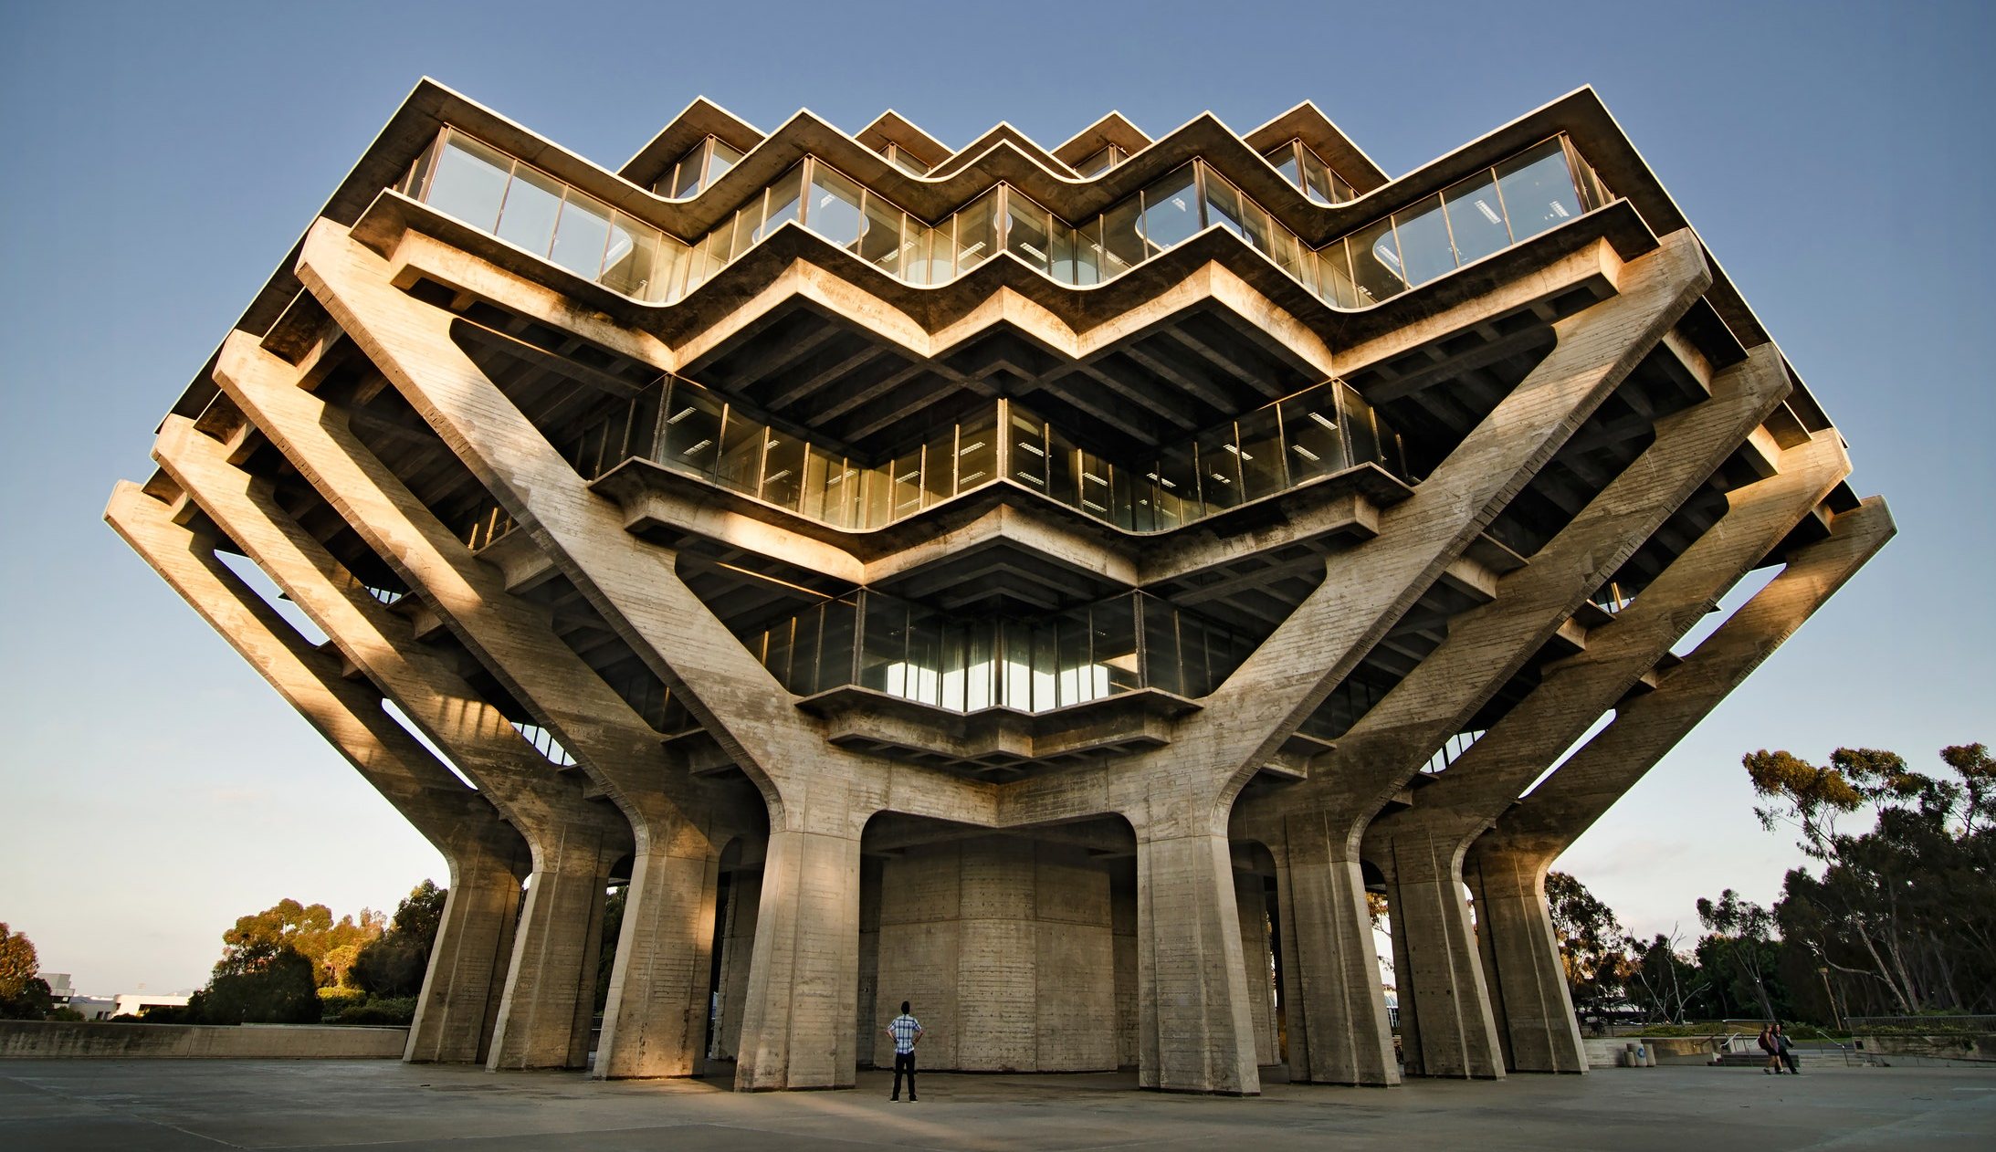
Problem Statement
A
Source: Nast, C. (2018) The 9 brutalist wonders of the architecture world, GQ.
Notes:
Concrete allows us to build amazing structures

Slide 26
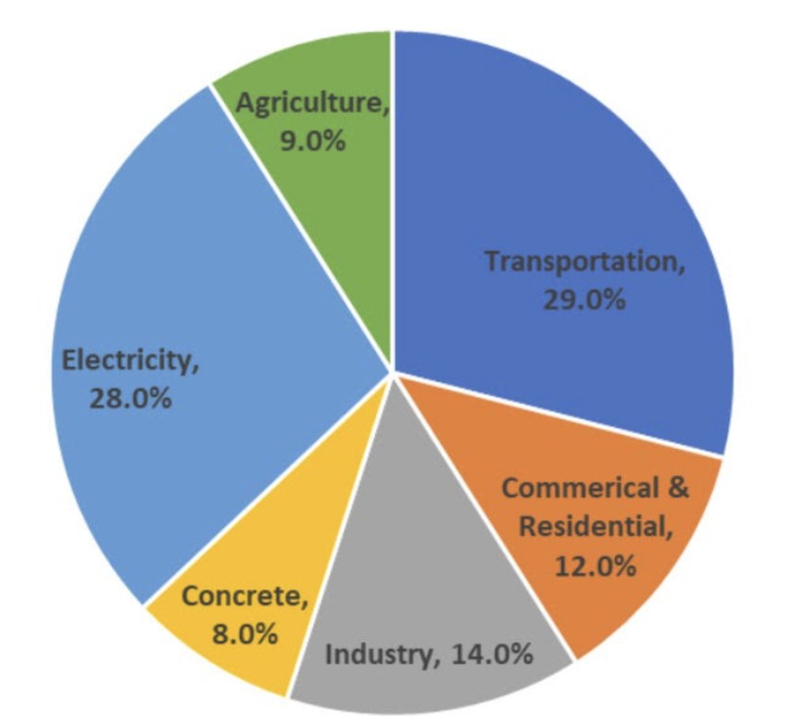
Problem Statement
A
B
Source: Nast, C. (2018) The 9 brutalist wonders of the architecture world, GQ.
Source: Ramsden, Princeton Edu., 2020
Notes:
BUT responsible for massive carbon footprint (8%)

Slide 27
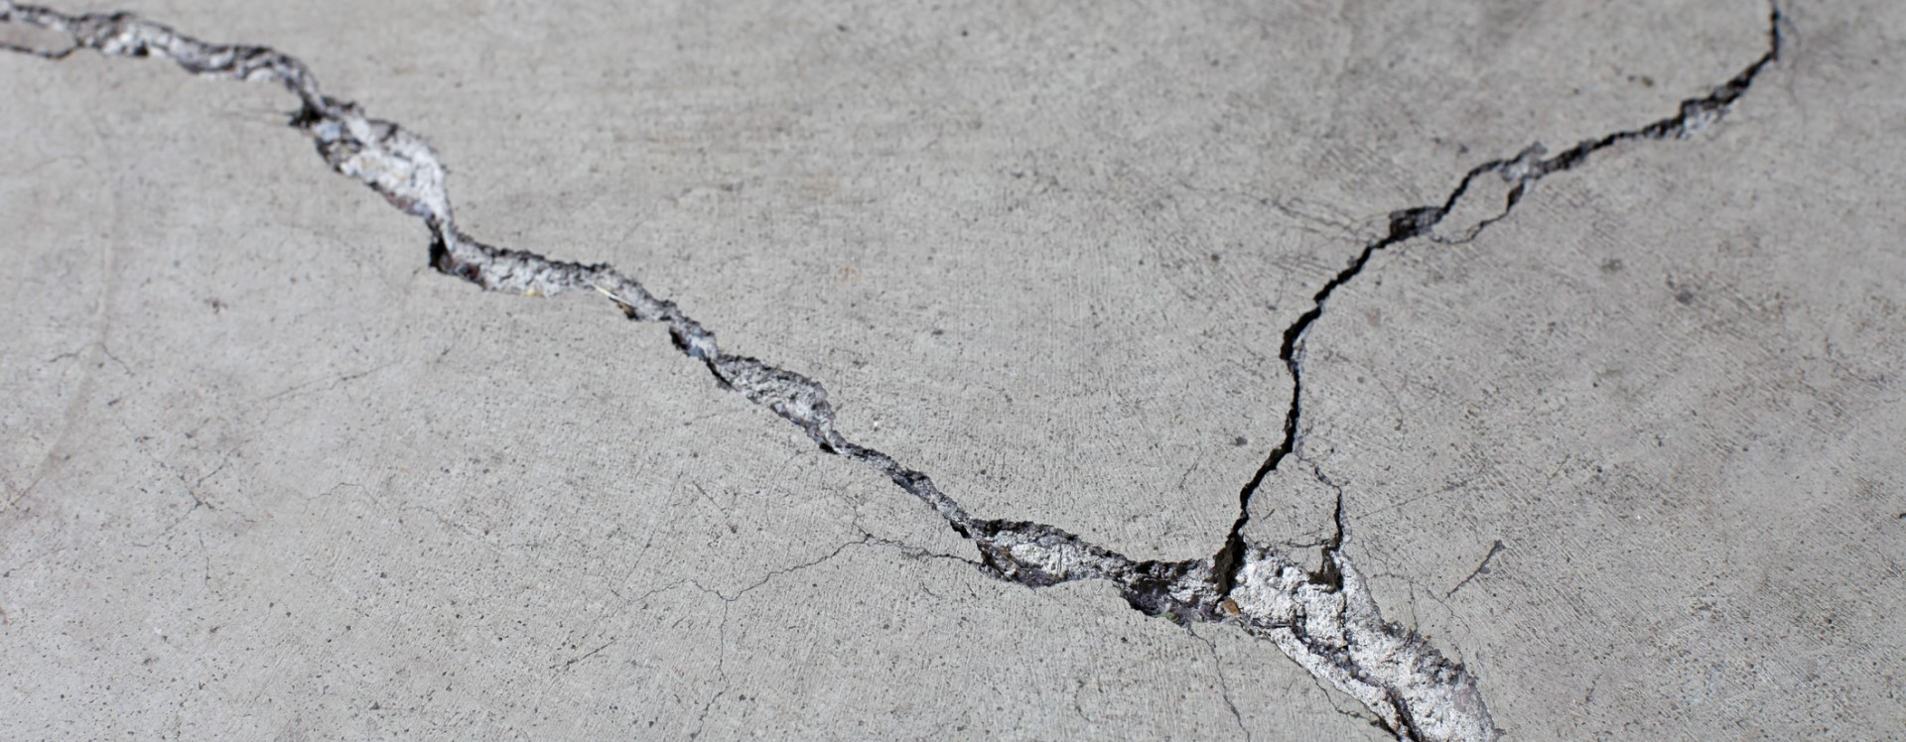
Concrete cracks
Notes:
Cracks occur from natural wear and tear – inevitable
Safety concerns -> maintenance and repair
-> costly (direct & indirect)
-> reduced service life of buildings -> new buildings -> emissions from new buildings

Slide 28
Concrete cracks
What if we could create self-healing concrete?
Notes:
Cracks occur from natural wear and tear – inevitable
Safety concerns -> maintenance and repair
-> costly (direct & indirect)
-> reduced service life of buildings -> new buildings -> emissions from new buildings

Slide 29
Concrete cracks
Notes:
Cracks occur from natural wear and tear – inevitable
Safety concerns -> maintenance and repair
-> costly (direct & indirect)
-> reduced service life of buildings -> new buildings -> emissions from new buildings

Slide 30
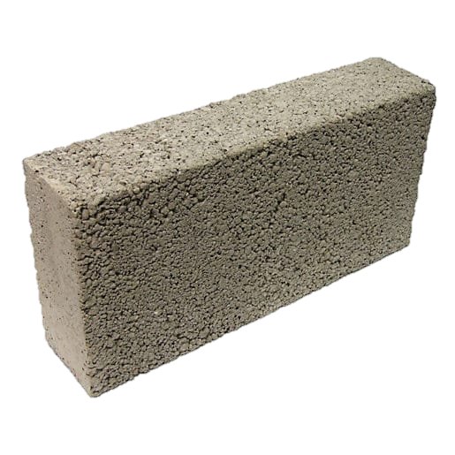
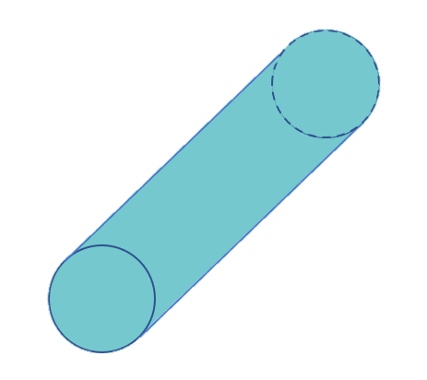
Overarching aim
Notes:
Significance of project with respect to literature -> bio-inspired, caco3 brittle and not the best healing material

